Slide 1
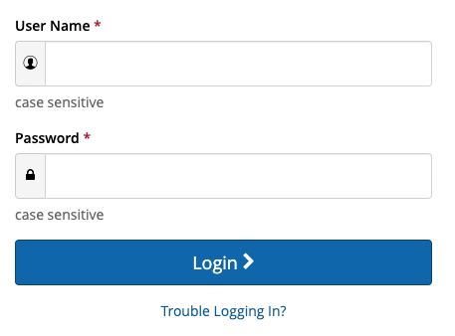
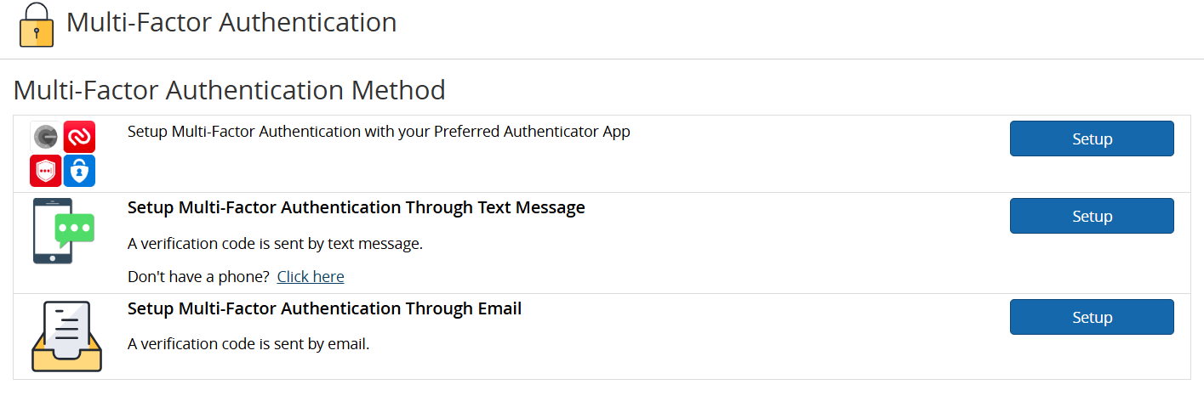

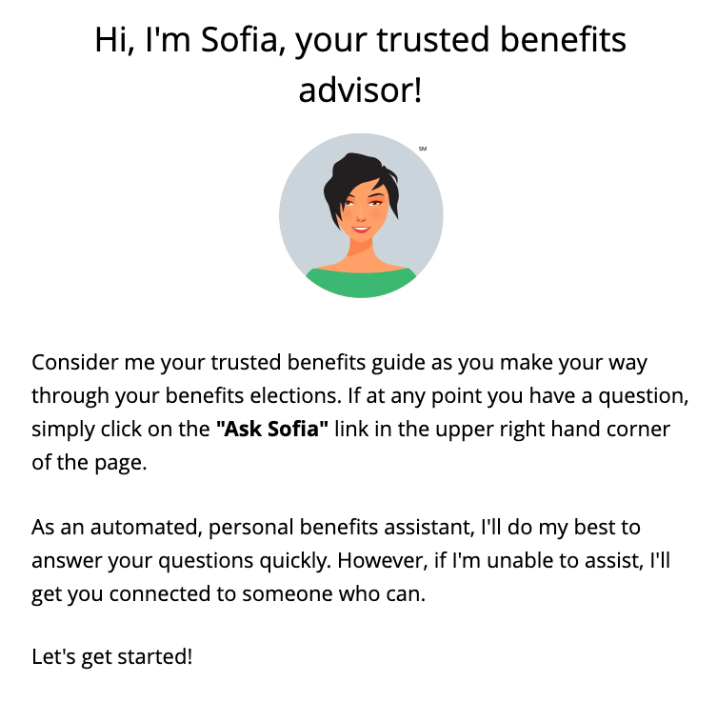
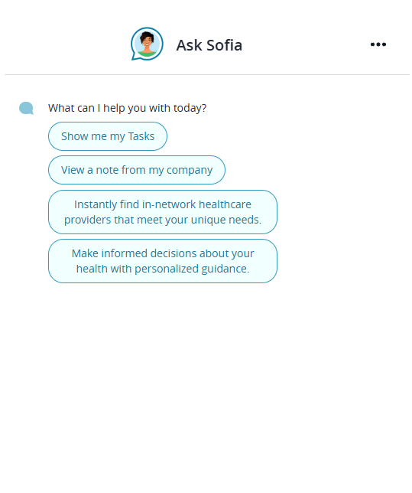
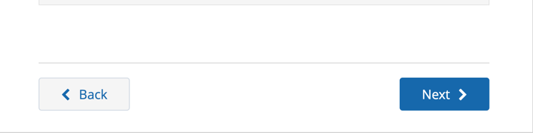
How to enroll in your benefits
Your Logo Here
REGISTER AND LOGIN
Visit www.benefitsolver.com and click the Register button to get started. The case-sensitive company key is xxxxxx.
Create your user name and password and verify your personal information.
Log in using your new user name and password.
Set up your Multi-Factor Authentication preferences. This will be your authentication process each time you visit the site going forward.
EXPLORE YOUR OPTIONS
Explore the site to learn about your benefits. You’ll find lots of helpful information in the Reference Center, located at the top of the page in the navigation menu.
The calendar at the top of the Home page lets you know how many days you have left to enroll.
START YOUR ENROLLMENT
Click the Start Here button to review your personal information and add or edit any dependents you wish to cover.
You will need to provide each dependent’s legal name, Social Security number, and birth date to add them to your coverage. Note, you will be required to provide documentation to prove your relationship to each dependent for certain coverages.
Sofia, your personal benefits assistant, can answer questions and guide you as you enroll.
Reminder: DO NOT use your browser’s arrows to navigate between pages. Instead, use the Back and Next buttons located at the bottom of each screen.
RETURNING USERS: Click on the Trouble Logging In? link to reset your login details.
www.benefitsolver.com
Company Key: XXXXXXXXX

Slide 2
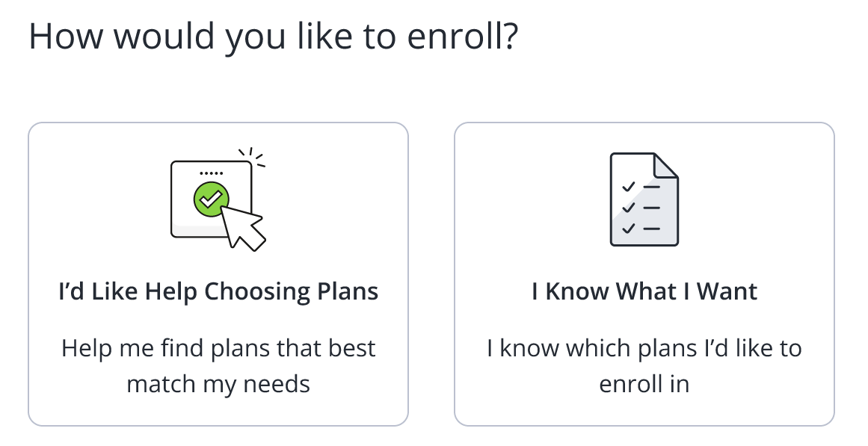
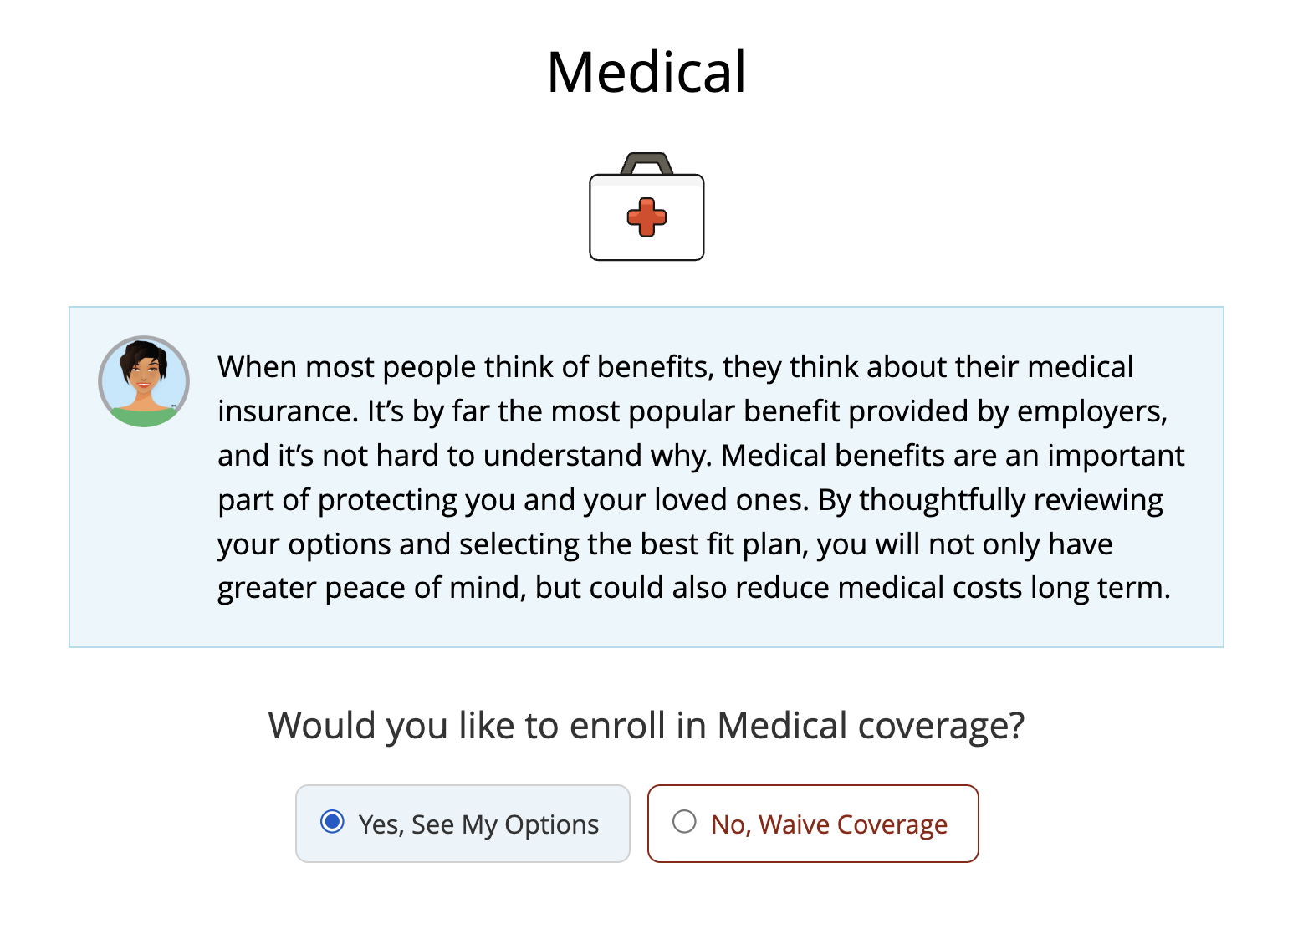
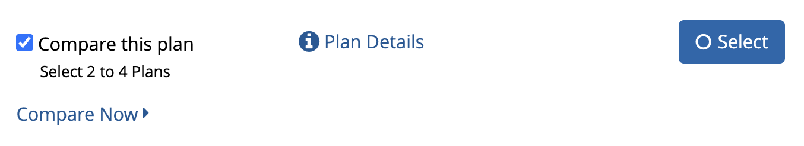
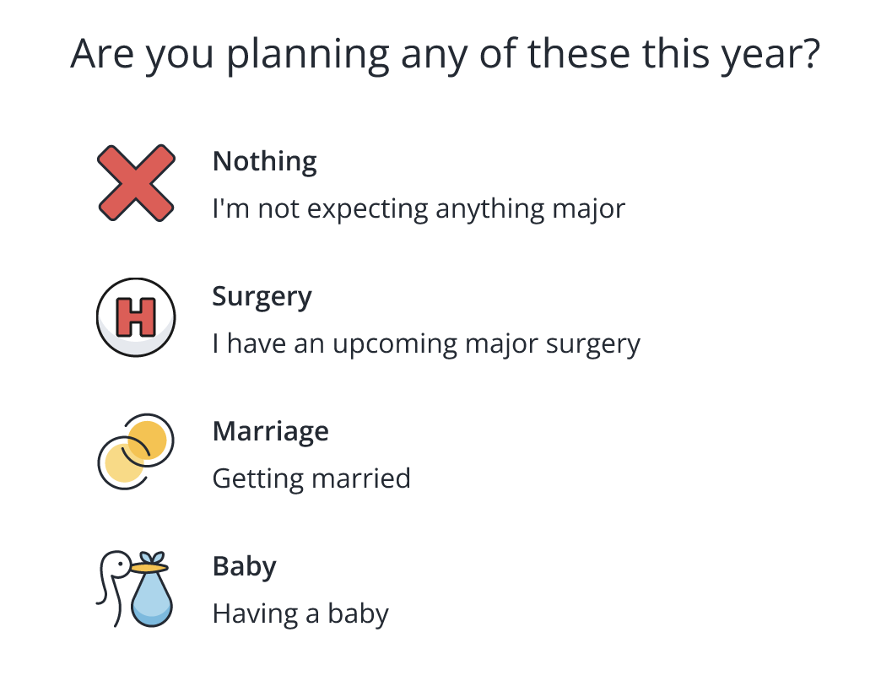
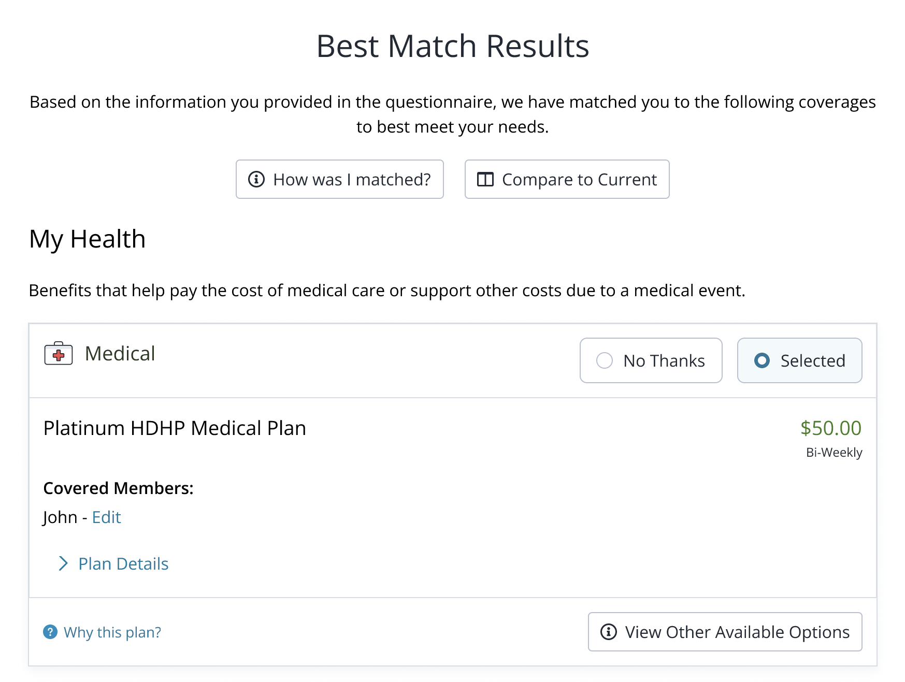

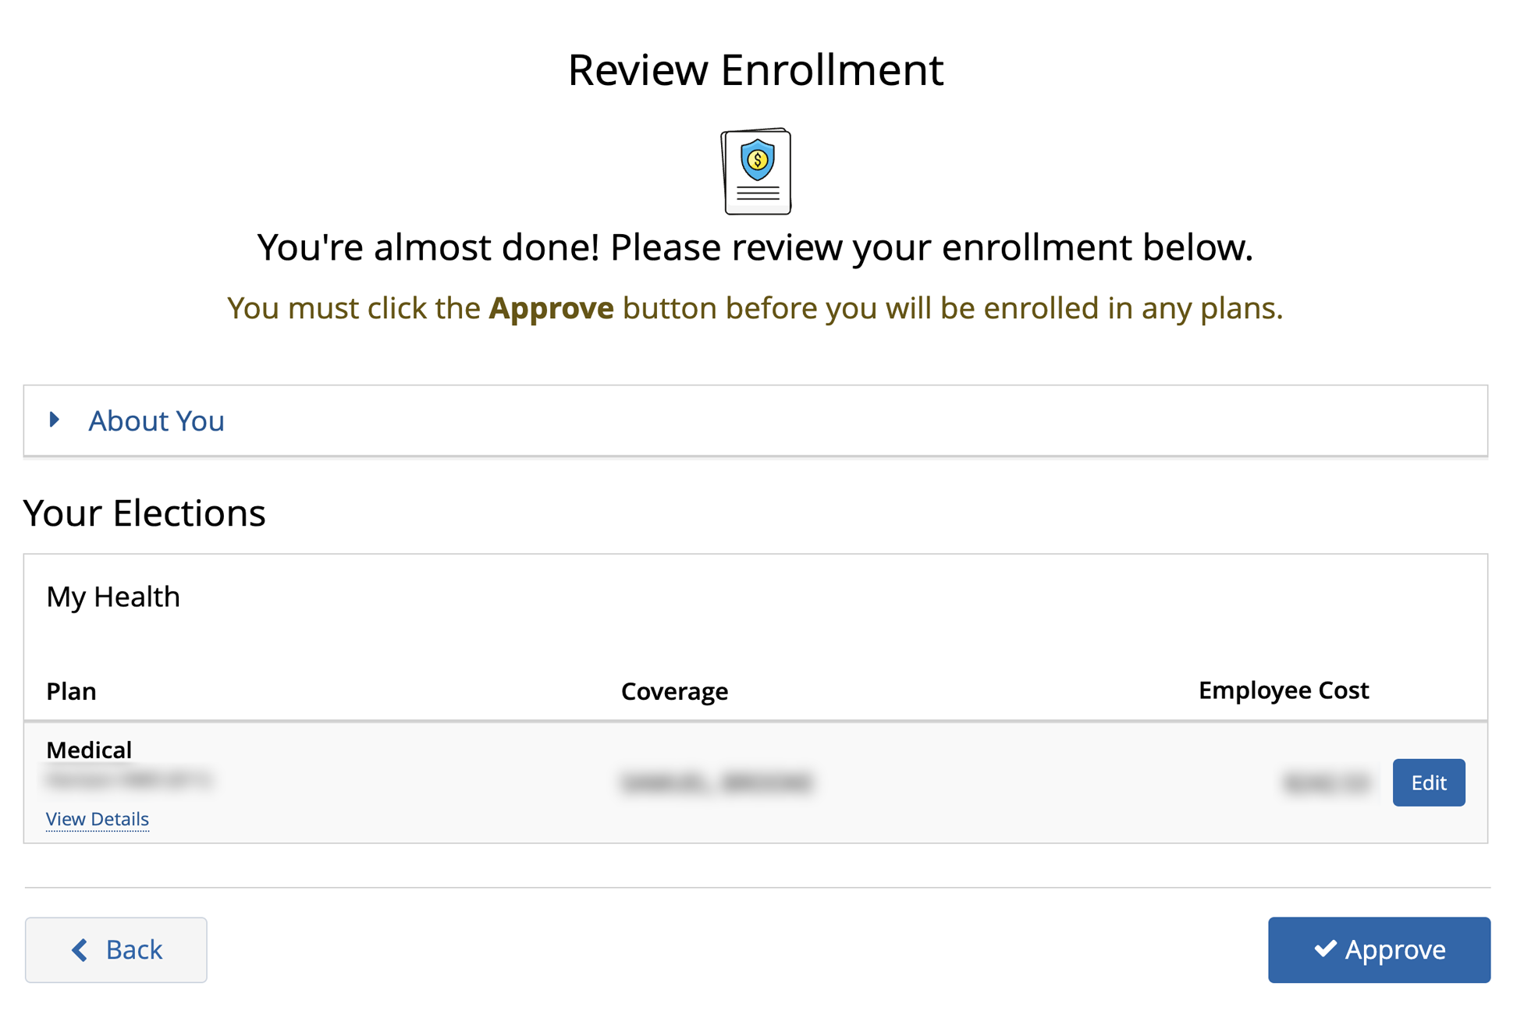
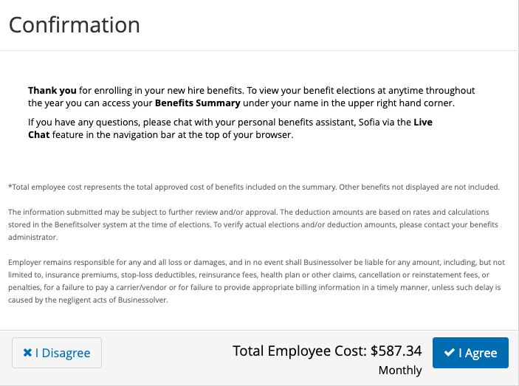
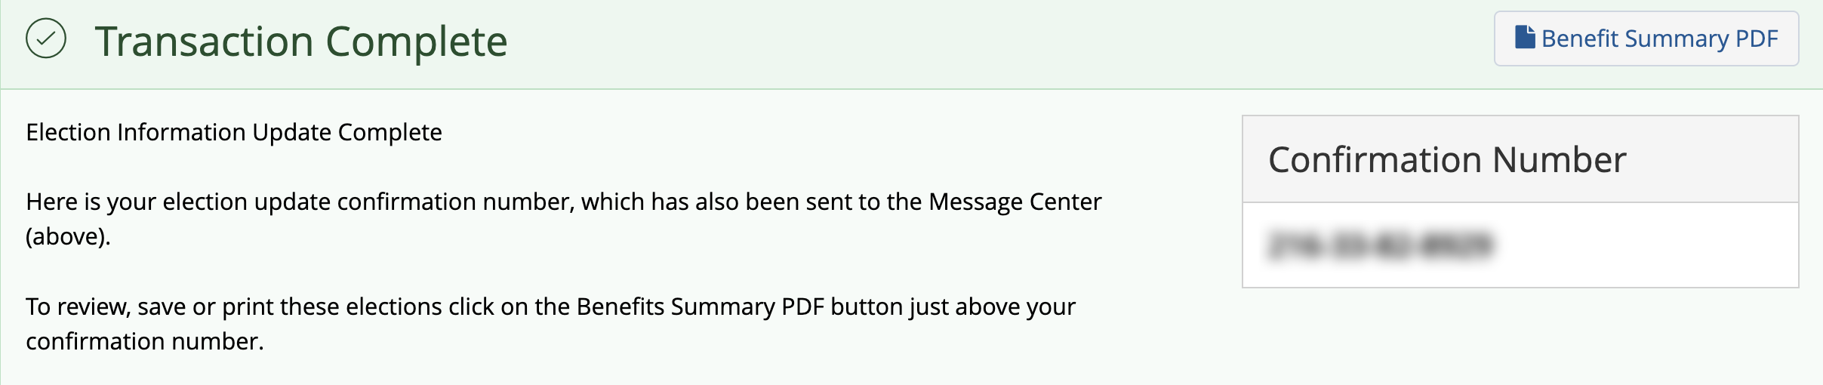
ENROLL IN COVERAGE
After you’ve reviewed your information and added any necessary dependents, you will be presented with multiple options for electing your benefits:
Already know what you want?
If you already know which benefits are right for your needs, this path walks you through each coverage one at a time. Click I Know What I Want to select or waive each coverage option and determine which dependents you want to cover.
View Plan Details and choose at least 2 plans to Compare your options.
Need help choosing?
Choosing which benefits are right for you shouldn't be a mystery—and our decision support tool is here to help!
Select I’d Like Help Choosing Plans and answer
a few simple questions to find the plans that best fit your unique needs. Your answers to all questions are confidential and the progress dots along the bottom of the screen indicate how many questions are remaining.
Once completed, review your Best Match Results, based on your answers. You can review each option, see all plans offered, and change your coverage as you see fit. Verify your elections are accurate and click Looks Good to proceed.
REVIEW AND FINALIZE YOUR ELECTIONS
After you’ve reviewed each individual benefit election, it’s time to review your enrollment at large. Make
sure your personal information, elections, dependents, and beneficiary(ies) are accurate, then Approve your elections.
To finish, click I Agree. When your enrollment is complete, you will receive a confirmation number and can print your Benefit Summary for your records.
www.benefitsolver.com
Company Key: XXXXXXXXX

Slide 3
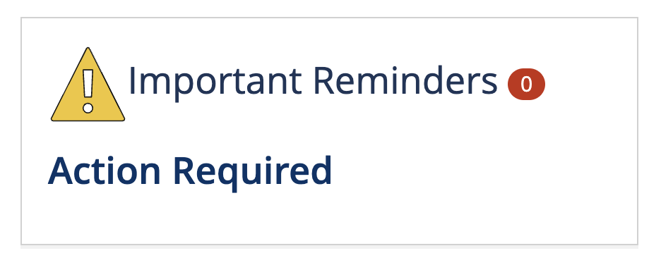
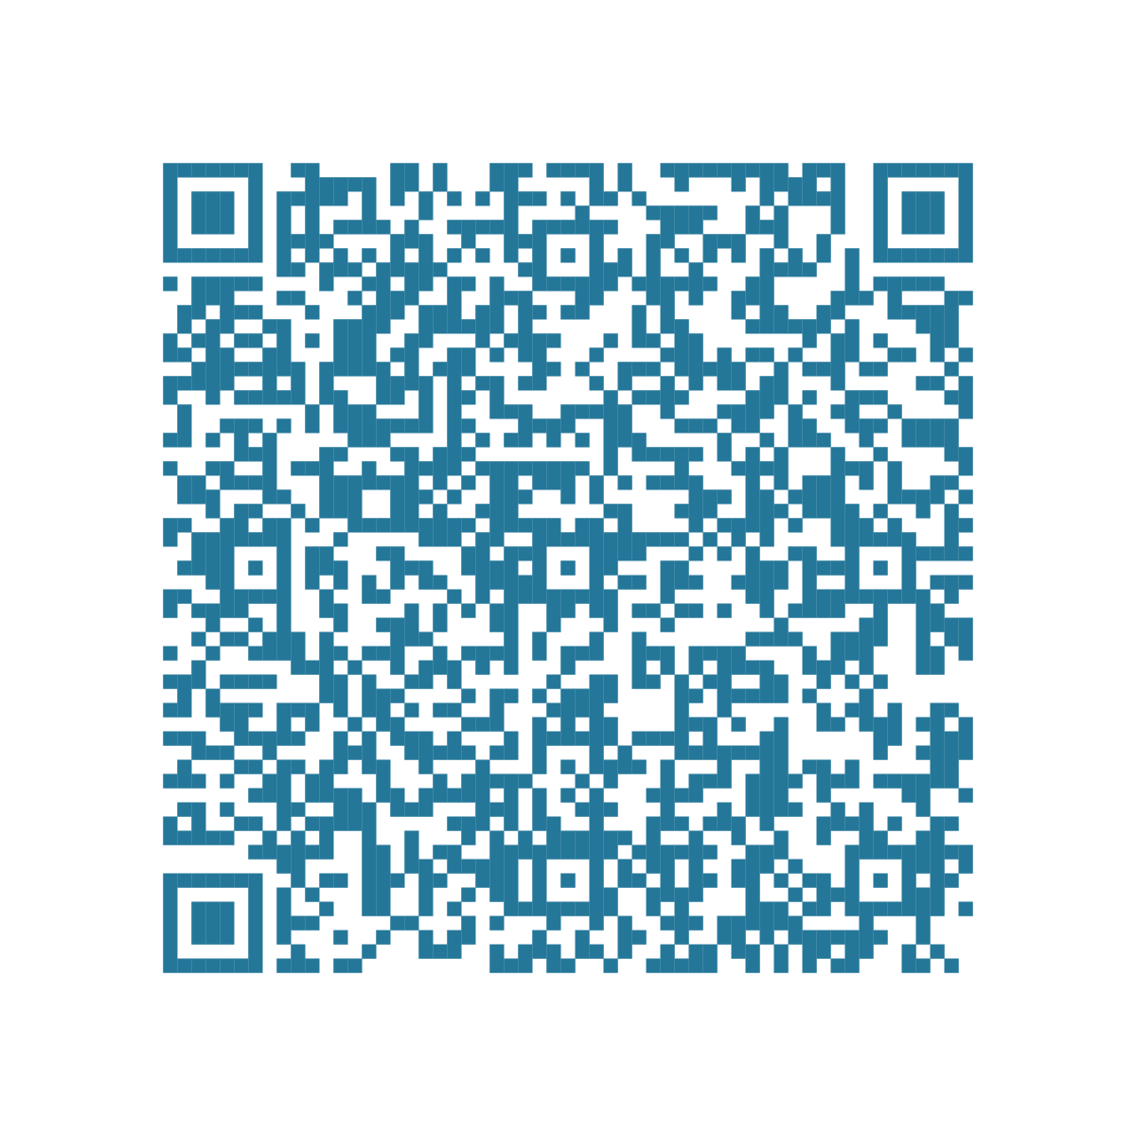
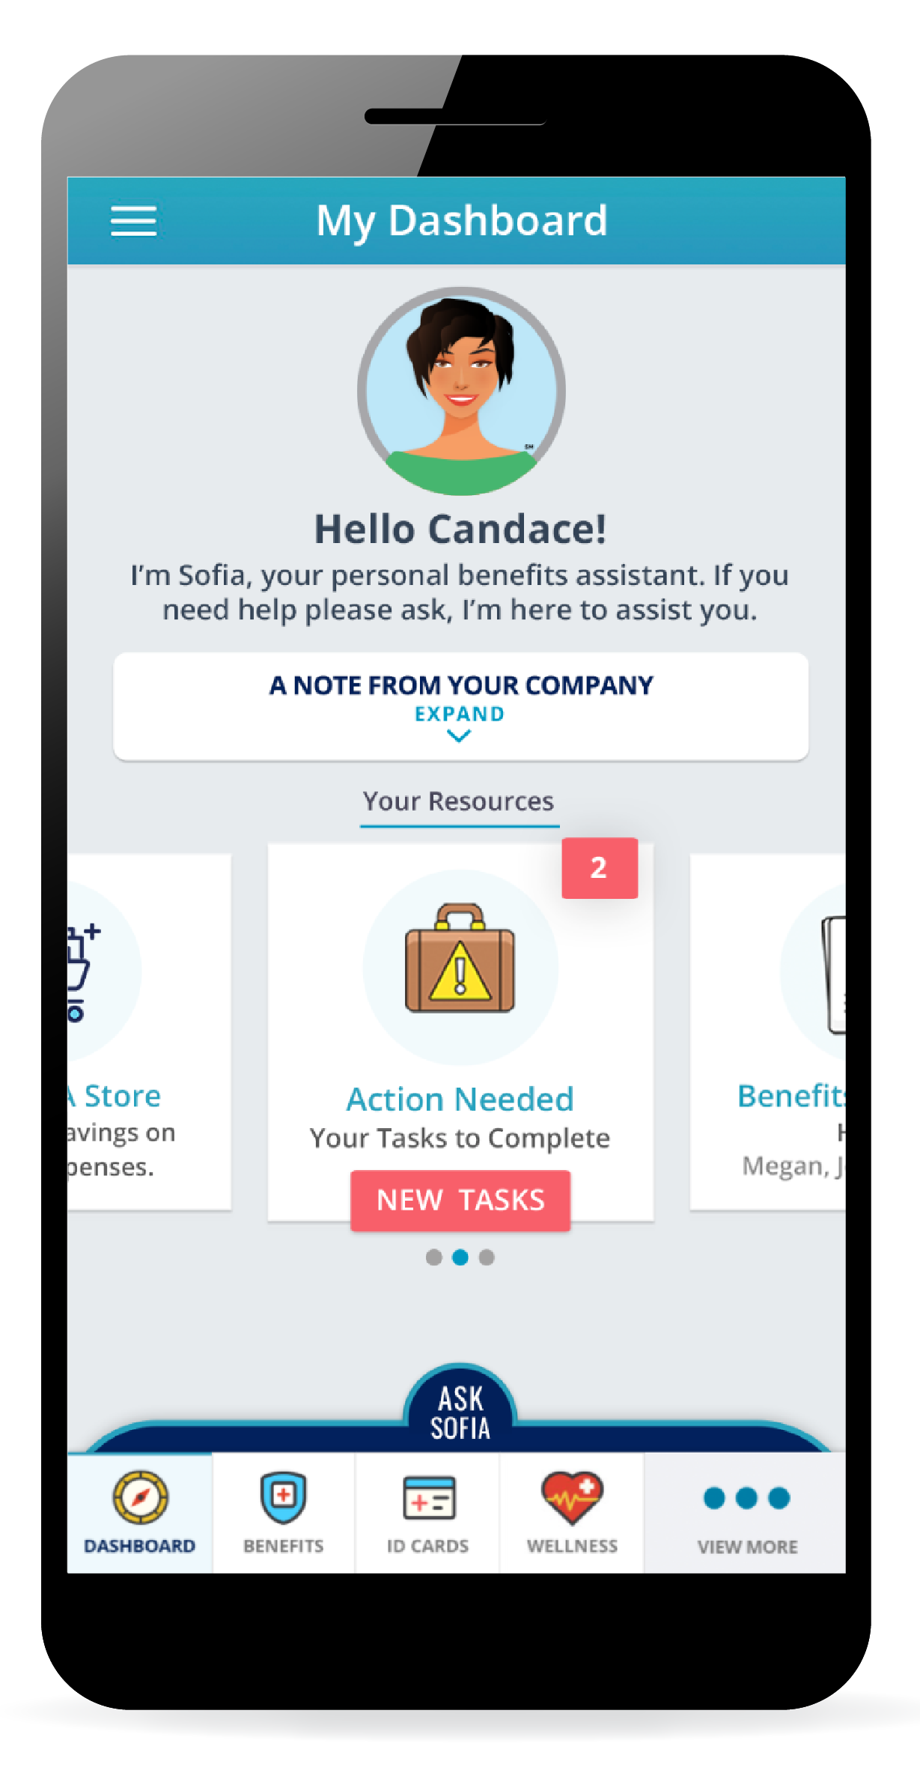
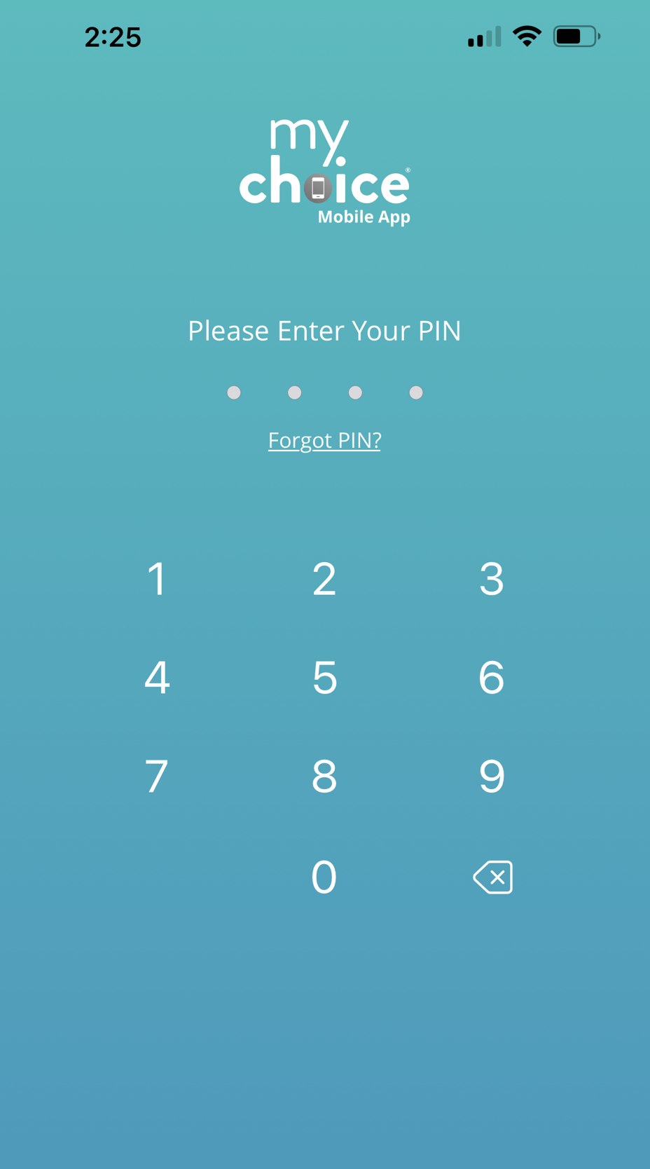
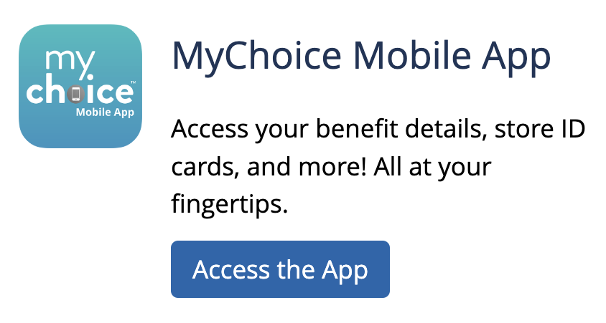
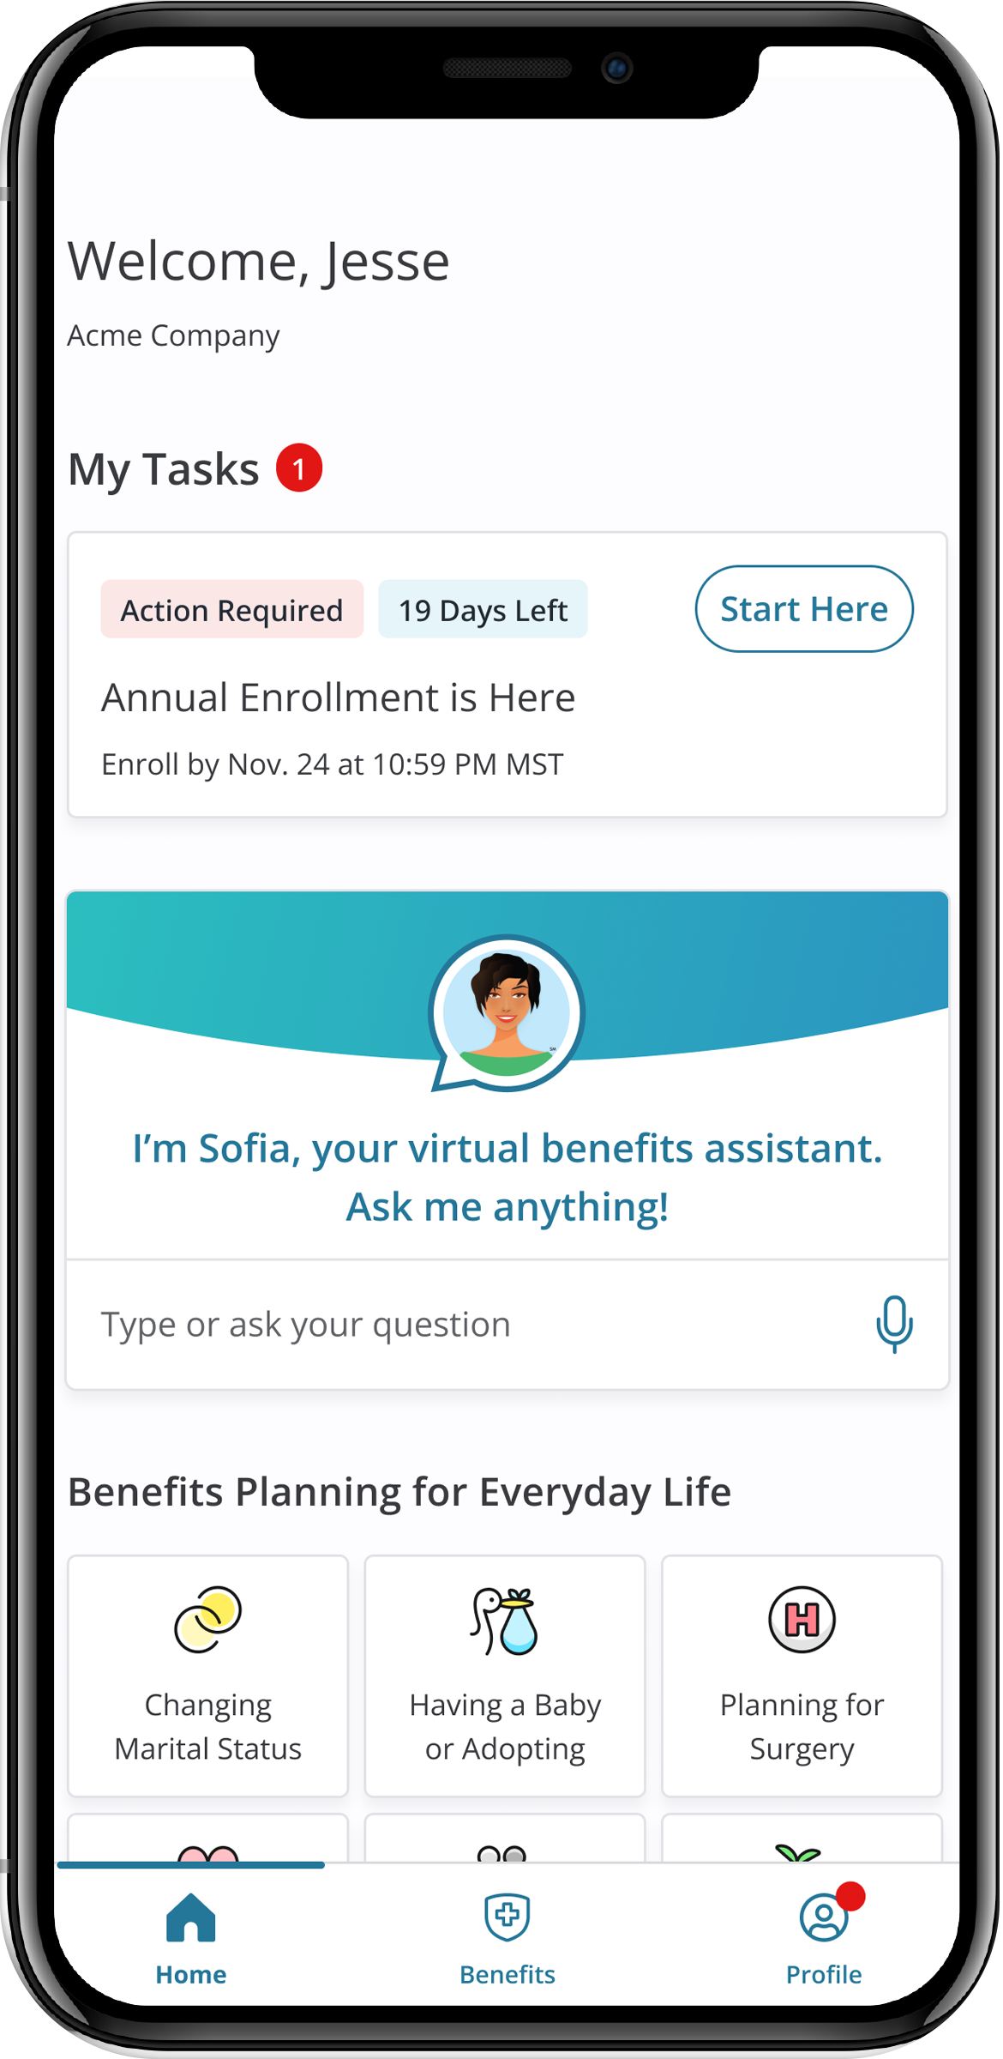

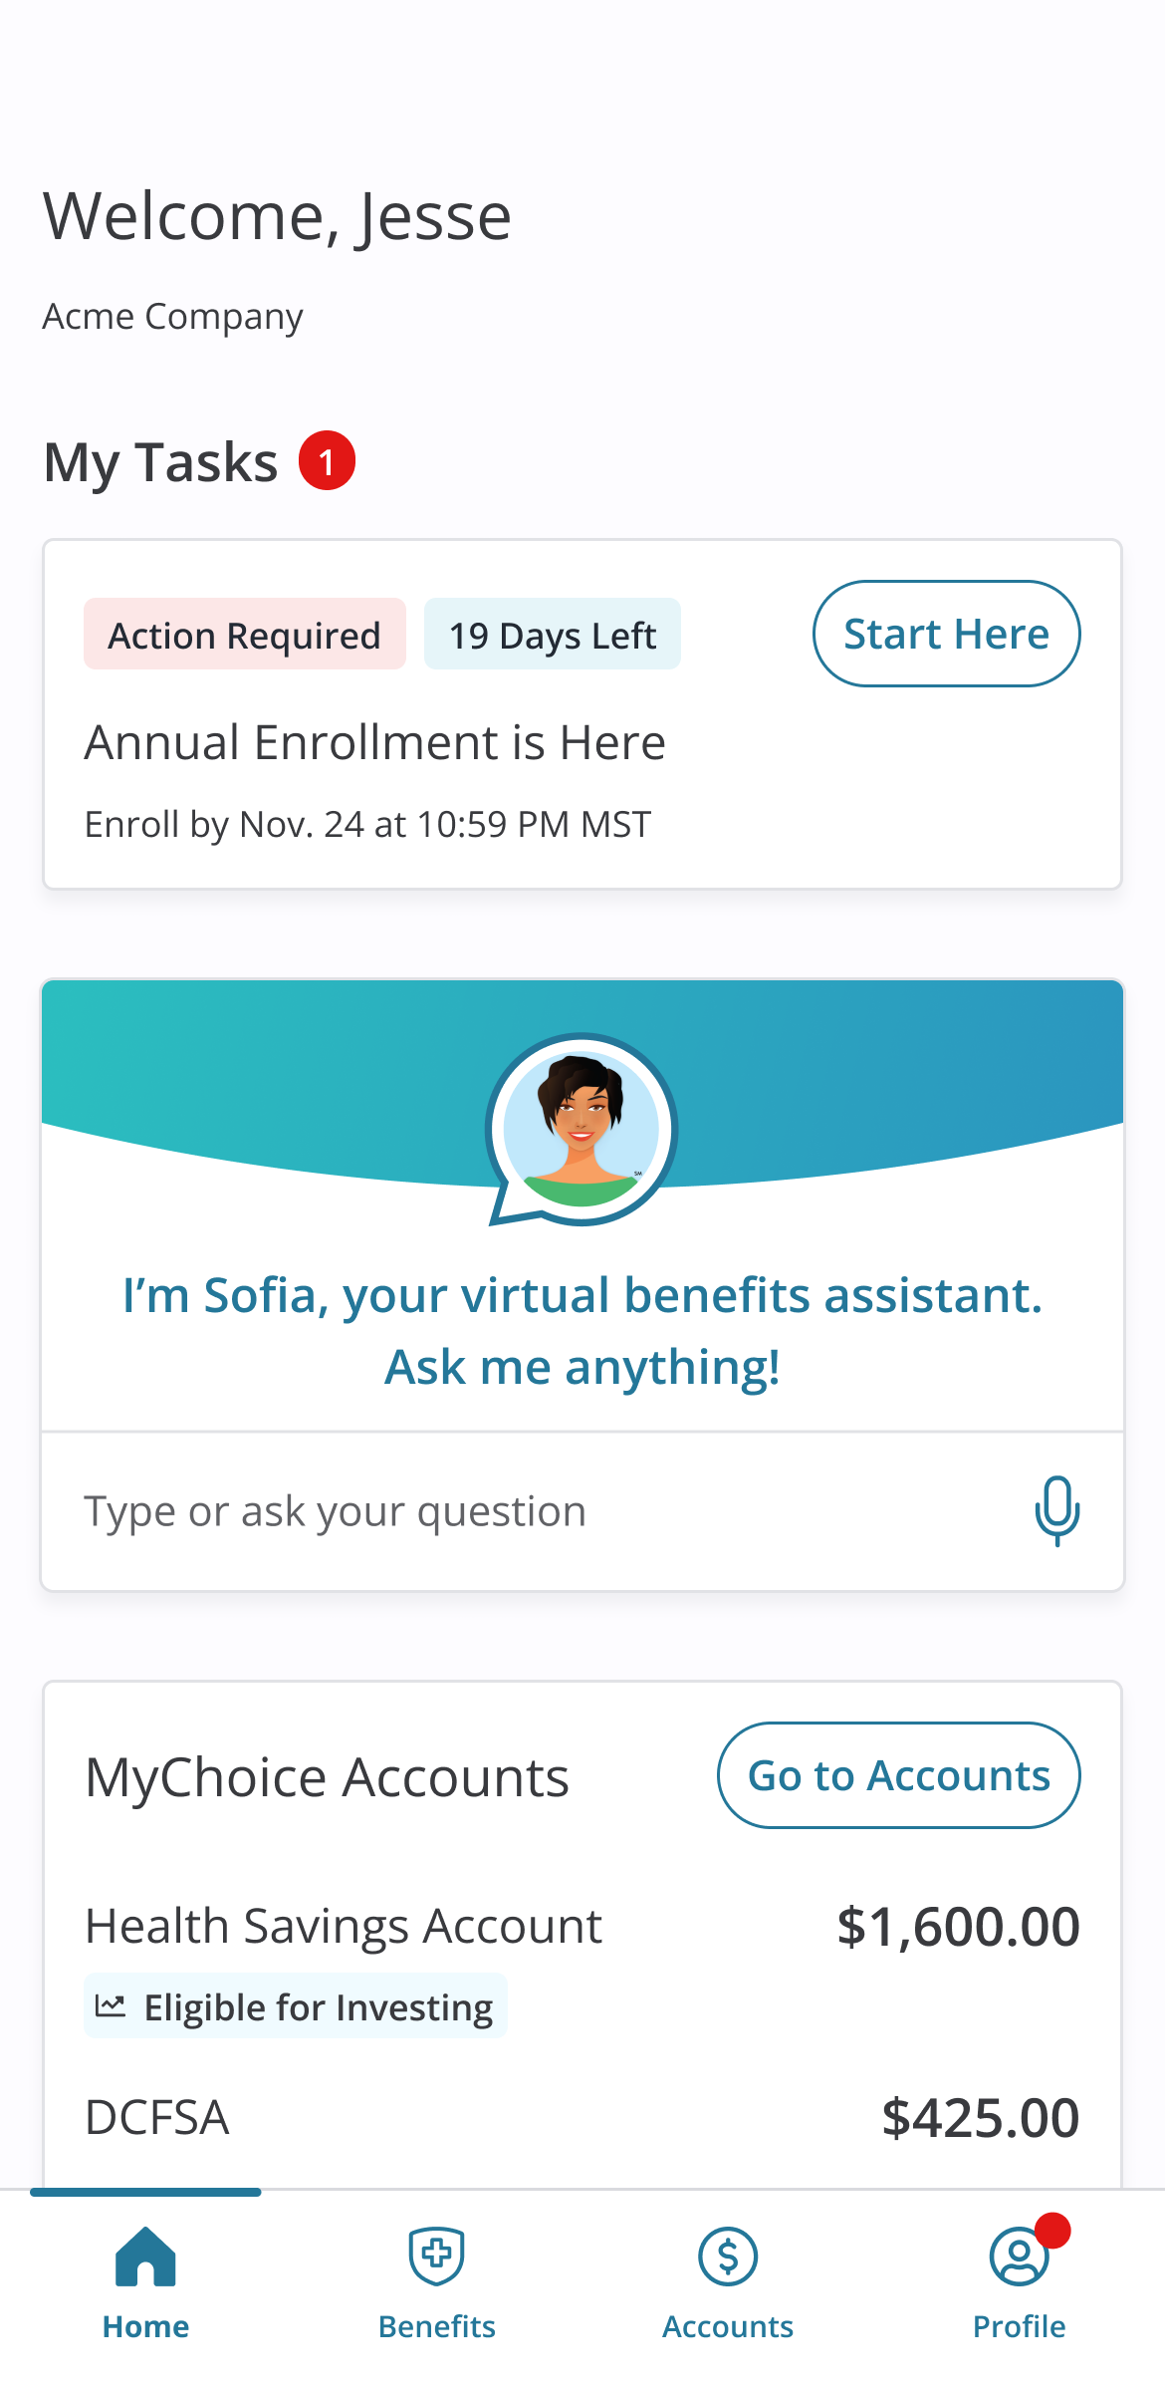

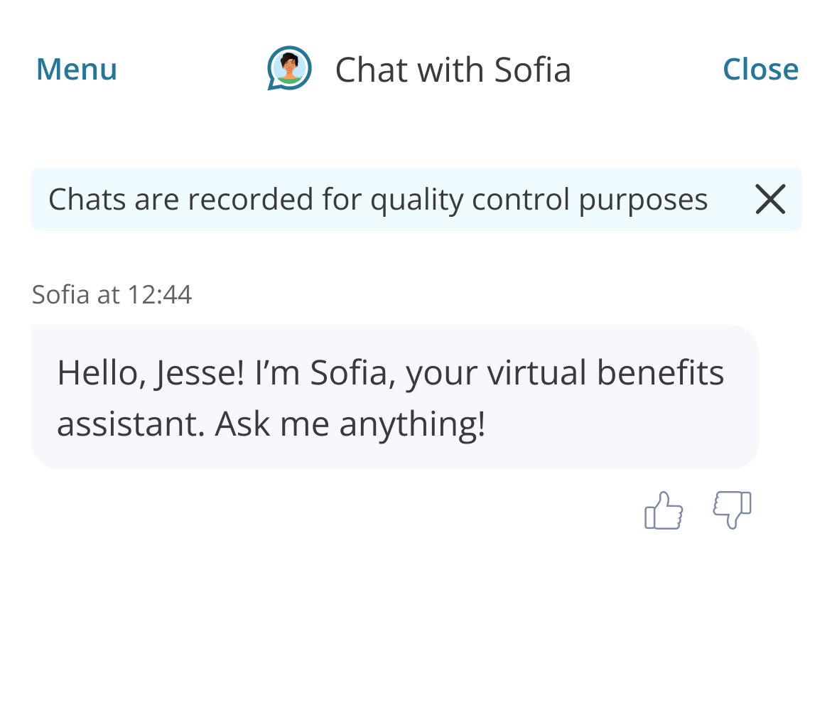
AFTER YOU ENROLL
Check your Important Reminders for actions needed to complete your enrollment.
Find helpful information on the
I Want To… Learn About > Dependent Verification page.
Access your Benefit Summary for accuracy of your information and elections.
Download the MyChoice® benefits app to manage and access all your benefits information on the go. Click Access the App
at [URL] to get started, or scan the QR code to the right to download the app on your device.
Visit this site year-round to learn more about your benefits, find plan information, and access tools to improve your health.
QUESTIONS? ASK SOFIA
Whether you need help with your enrollment or have questions about your benefits, you can chat with Sofia, your 24/7 personal benefits assistant. Find Sofia in the MyChoice® benefits app and [Benefitsolver/URL].
If she can’t answer your questions, she will point you in the right direction for answers.
Sofia speaks over 50 languages, and can answer questions regarding 400,000 benefits topics, including:
MyChoice Accounts
Coverage questions
Plan comparisons
Enrollment deadlines
Dependent coverage
ID cards
And many more!
AFTER YOU ENROLL
Check your Important Reminders for actions needed to
complete your enrollment. Find helpful information on the
I Want To… Learn About > Dependent Verification page.
Review your Benefit Summary for accuracy of your information and elections.
Download the MyChoice® benefits app to manage and access all your benefits information on the go. Click Access the App to get started or scan the QR code to the right to download the MyChoice benefits app to your device.
Visit this site year-round to learn more about your benefits, find plan information, and access tools to improve your health.
Your Logo Here
QUESTIONS?
Sofia will be by your side when you enroll, and she will provide important documents. She can answer many of your questions 24/7 in over 20 languages. Find her on the mynjbenefitshub and on the MyChoice benefits app.
If she can’t answer your question, contact your local Human Resources Department, Benefits Administrator, or your Certifying Officer for additional assistance.
www.benefitsolver.com
Company Key: XXXXXXXXX

