Slide 1
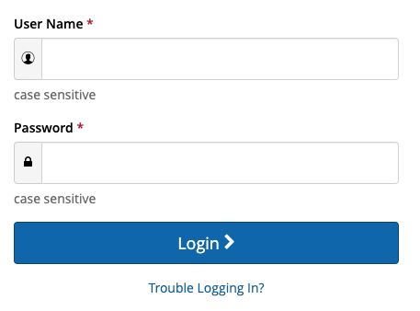
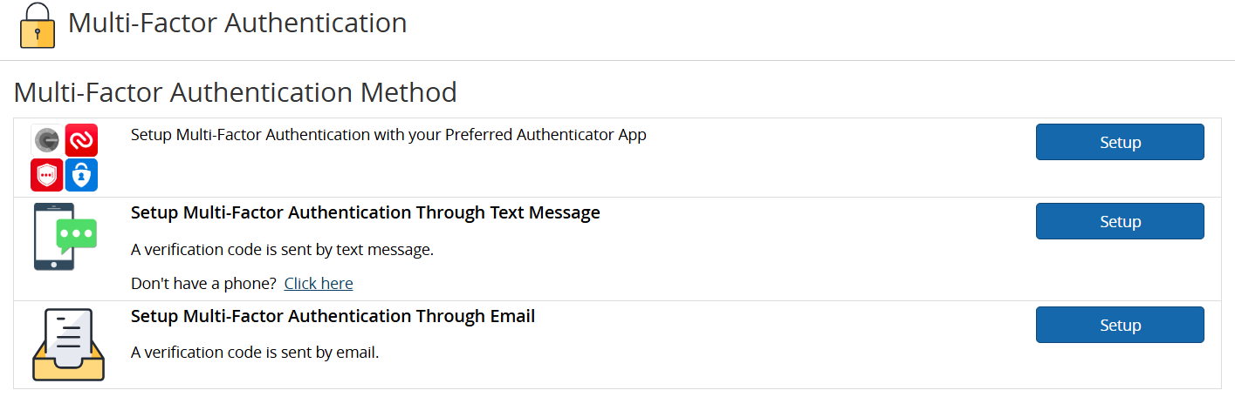

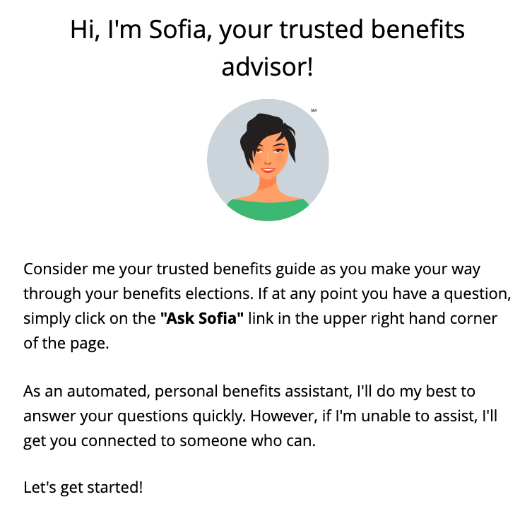
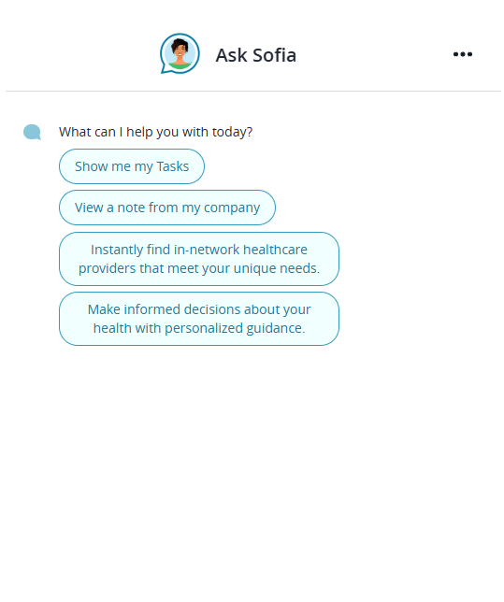
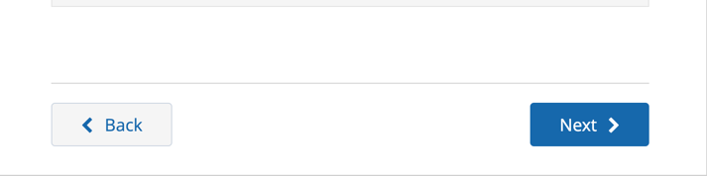
How to enroll in your benefits
Your Logo Here
REGISTER AND LOGIN
Visit www.benefitsolver.com and click the Register button to get started. The case-sensitive company key is xxxxxx.
Create your user name and password and verify your personal information.
Log in using your new user name and password.
Set up your Multi-Factor Authentication preferences. This will be your authentication process each time you visit the site going forward.
EXPLORE YOUR OPTIONS
Explore the site to learn about your benefits. You’ll find lots of helpful information in the Reference Center, located at the top of the page in the navigation menu.
The calendar at the top of the Home page lets you know how many days you have left to enroll.
START YOUR ENROLLMENT
Click the Start Here button to review your personal information and add or edit any dependents you wish to cover.
You will need to provide each dependent’s legal name, Social Security number, and birth date to add them to your coverage. Note, you may be required to provide documentation to prove your relationship to each dependent.
Sofia, your personal benefits assistant, can answer questions and guide you as you enroll.
Reminder: DO NOT use the back page arrow in your browser to navigate between pages. Instead, use the Back and Next buttons located at the bottom of each screen.
RETURNING USERS: Click on the Trouble Logging In? link to reset your login details.
www.benefitsolver.com
Company Key: XXXXXXXXX

Slide 2
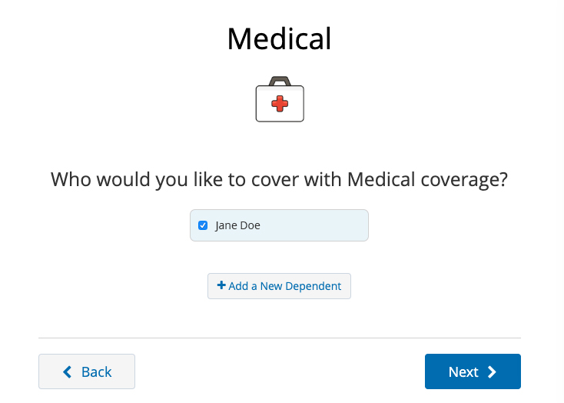

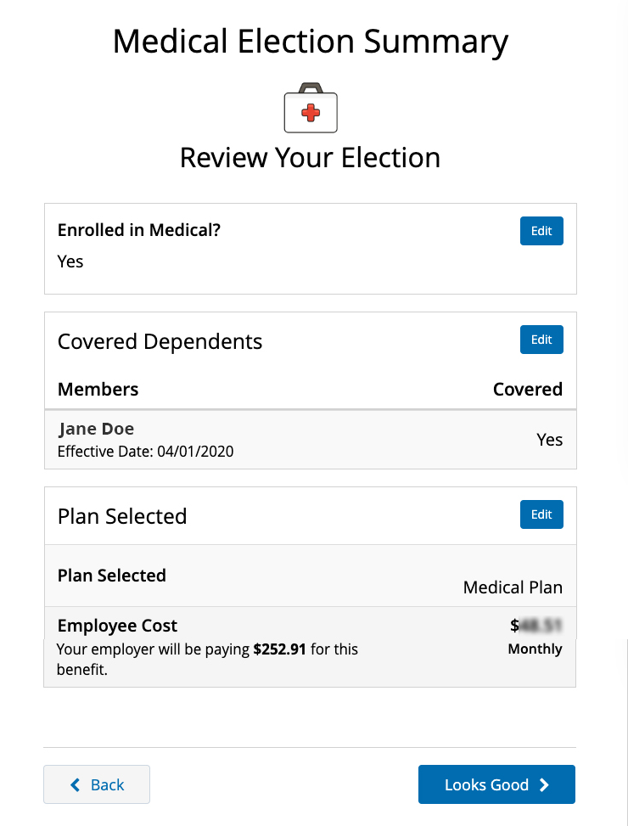
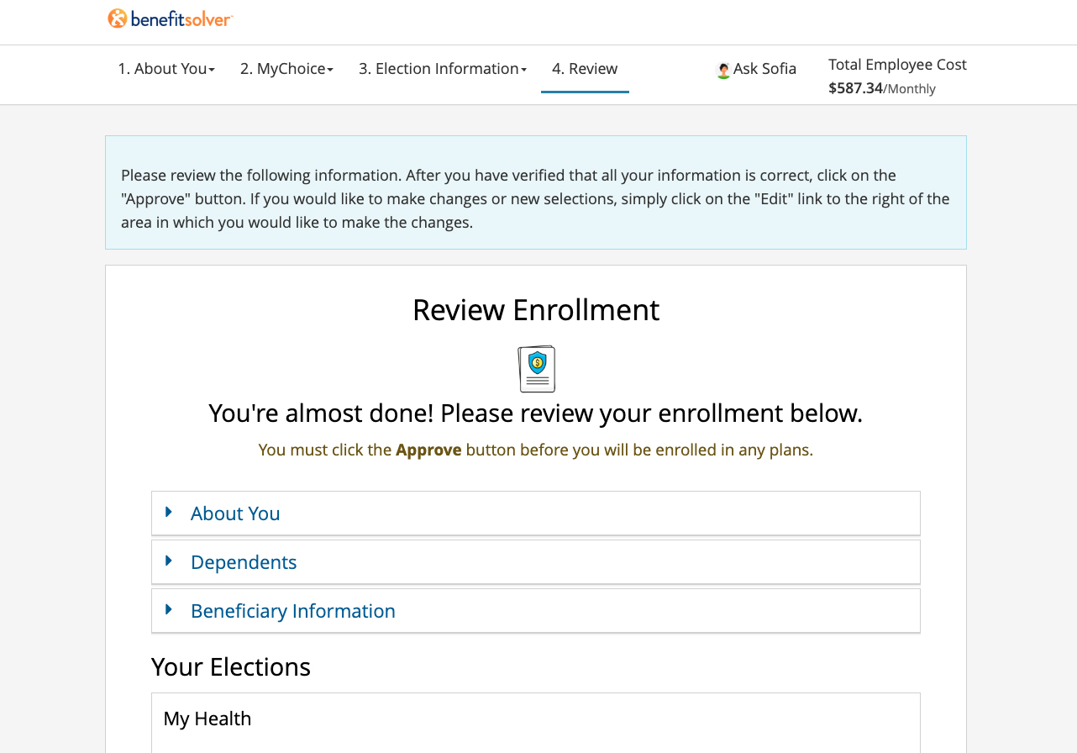
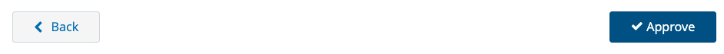
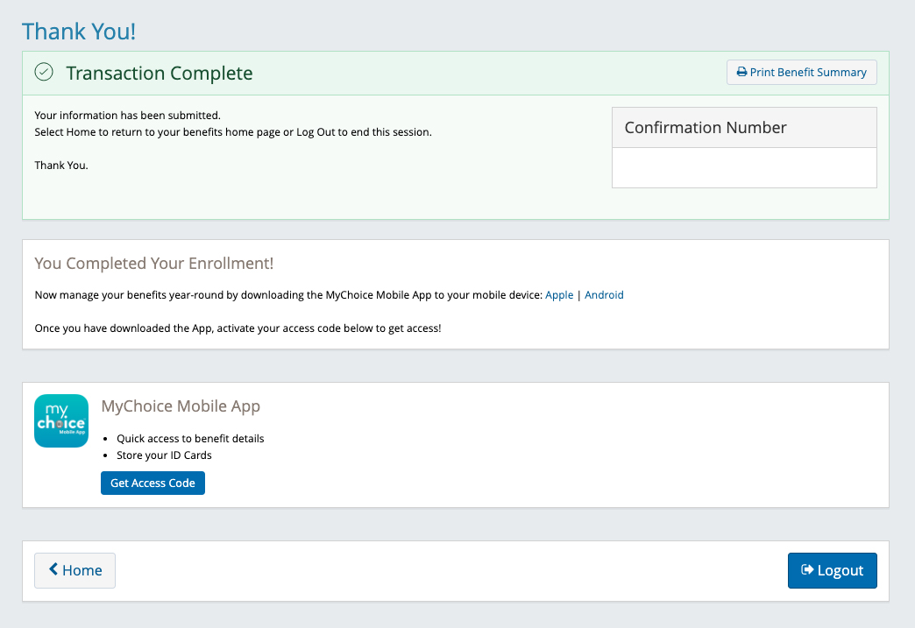
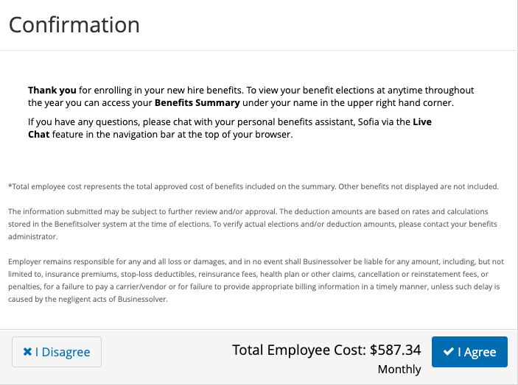
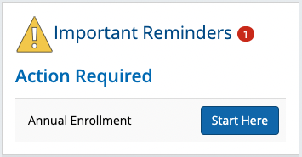
ENROLL IN COVERAGE
Use the Next and Back buttons to review and elect options available to you. Choose or decline coverage for each option, and select which family members you want to cover.
Review plan documents and use the Compare and Plan Details tools to view details and costs for the options available to you.
REVIEW AND FINALIZE YOUR ELECTIONS
Make sure your personal information, elections, dependents, and beneficiaries are accurate, then approve your elections.
To finish, click I Agree. When your enrollment is complete, you will receive a confirmation number and can print your Benefit Summary for your records.
AFTER YOU ENROLL
Return to the Home page to check for any additional tasks needed to complete your enrollment, view or download your Benefit Summary, and download the MyChoice® benefits app.
Visit this site anytime you want to learn more about your benefits or make a change to your coverage (if you experience a qualifying life event).
www.benefitsolver.com
Company Key: XXXXXXXXX

Slide 3
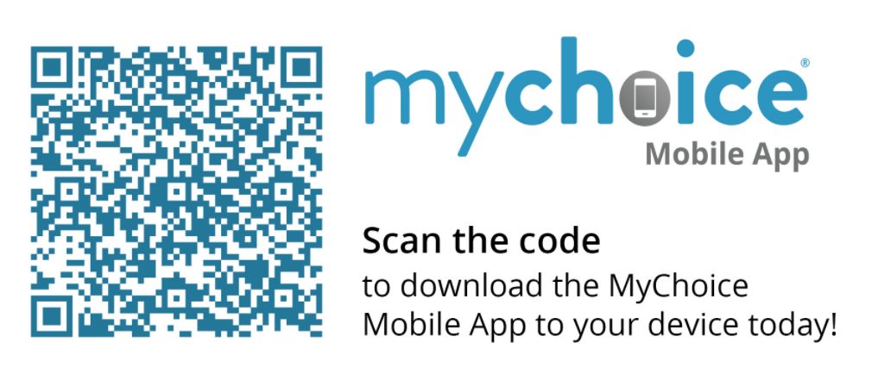
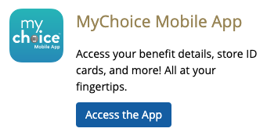
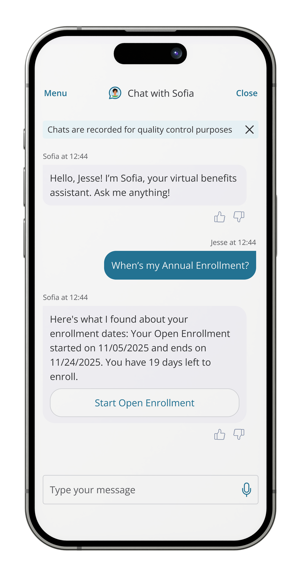
DOWNLOAD THE MYCHOICE® BENEFITS APP and manage all your benefits from your mobile phone!
See plan details, change your benefits, and submit claims
Manage your spending/saving accounts (if applicable)
Store digital copies of your ID cards
Upload dependent verification documents
Chat with Sofia directly through the app – she’s available 24/7 to help answer your questions
Contact a live member advocate on the phone or live chat
Click the Access App button to get started.
Or scan the QR code with your phone’s camera
to download it from the app store directly.
SOFIASM
Whether you need help with your enrollment or you just have questions about your benefits, you can chat with Sofia, your 24/7 personal benefits assistant. You can find her in the MyChoice® benefits app or on at the bottom of any page of [your website?]. If she can’t help you, she will refer you to a live agent.
Sofia can have conversations on over 400,000 benefits topics, including:
coverage questions
plan comparisons
enrollment deadlines
dependent coverage
ID cards
and many more!
Your Logo Here
www.benefitsolver.com
Company Key: XXXXXXXXX

