Slide 1
How to use this presentation
This presentation is designed to help HR leaders explain the key features of the spending and/or savings accounts offered to them by your organization.
This file is meant to be your template. There are items marked in green that might be specific to your organization’s plan design. Simply fill those in or remove them altogether and remove the highlighting for the final presentation.
There are a few red box notes to help you get the right information in your presentation. Determine which slides you need and delete the red box notes.
Use only the slides that align with your organization’s account types. If you do not have dependent care FSAs, just delete those slides.
For HSA, to simplify the presentation, you may remove the “SAVE” and “INVEST” sections.
There are explainer videos for each account type. Feel free to click on the graphic to play those or remove them from the presentation. You may have to “enable content” as these are linked within the presentation.

Slide 2
[Client Name] Benefits
Pre-tax Spending/Savings Accounts

Slide 3
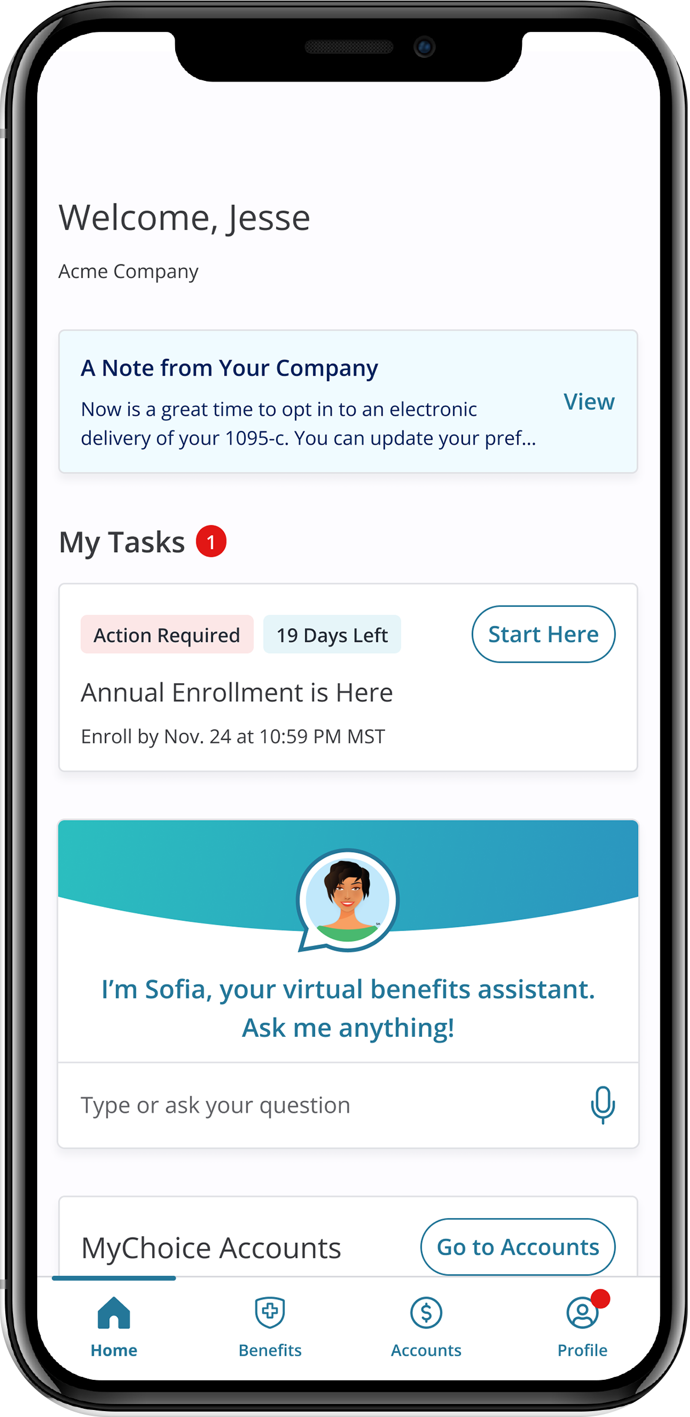


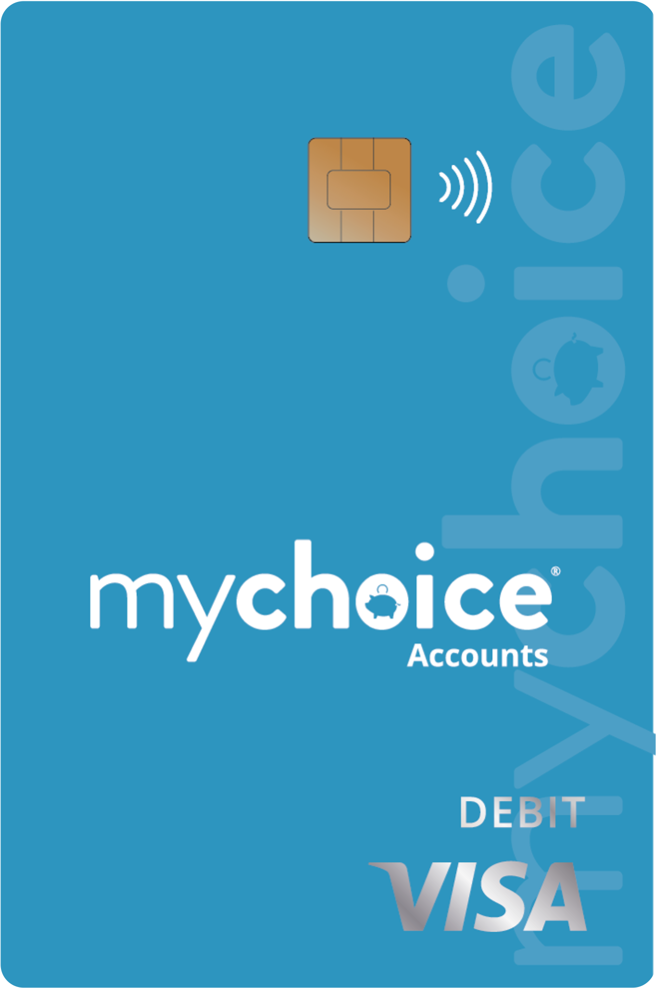
Who We Are
MyChoice® Accounts is your administrator for your health care flexible spending account (FSA), the dependent care FSA (DCFSA), and the health savings account (HSA).
Access these accounts in your Benefitsolver system either online or via the MyChoice benefits app, where you enroll in all your benefits.
Notes:
MyChoice Accounts, powered by Businessolver, will be the administrator of the [[insert plan types supported].
With MyChoice Accounts, it is easy to use your account. All participants will have access to an online portal, mobile app as well a payment card if you enroll in the {{account types}}. The card will give you quick and easy access to your account funds. This is the logo for MyChoice Accounts that you will see on communications and this is what your debit card will look like.

Slide 4
What Do These Accounts Cover?

Slide 5








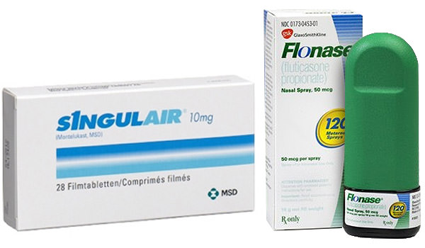
Think About What You Already Cover Out-of-Pocket…
…add it up and know you can cover these with a health care FSA or HSA
Notes:
So, to prepare for enrolling in an FSA account and/or HSA account it is a good idea to estimate how much you might spend every year on your medical, dental, vision, prescriptions as well as items you buy over the counter such as pain medicine like Advil or Tylenol in the picture, sun screen and even allergy medicine. Again, think about things like upcoming surgeries…or even if your child needs braces or other orthodontic work.
All of these items are covered with the Health Care FSA and the Health Savings Account, or HSA. So, you will be setting aside your money and saving that 20-30% in taxes every time you need to pay for something like this.
Did you know that the average American family spends about $1,600 in eligible healthcare expenses every year? You may as well do that tax-free with an FSA or HSA.
If you set aside $1,600 per year, that would be about $62 per pay period (on a bi-weekly pay schedule) and save you on average about $384 in taxes.

Slide 6
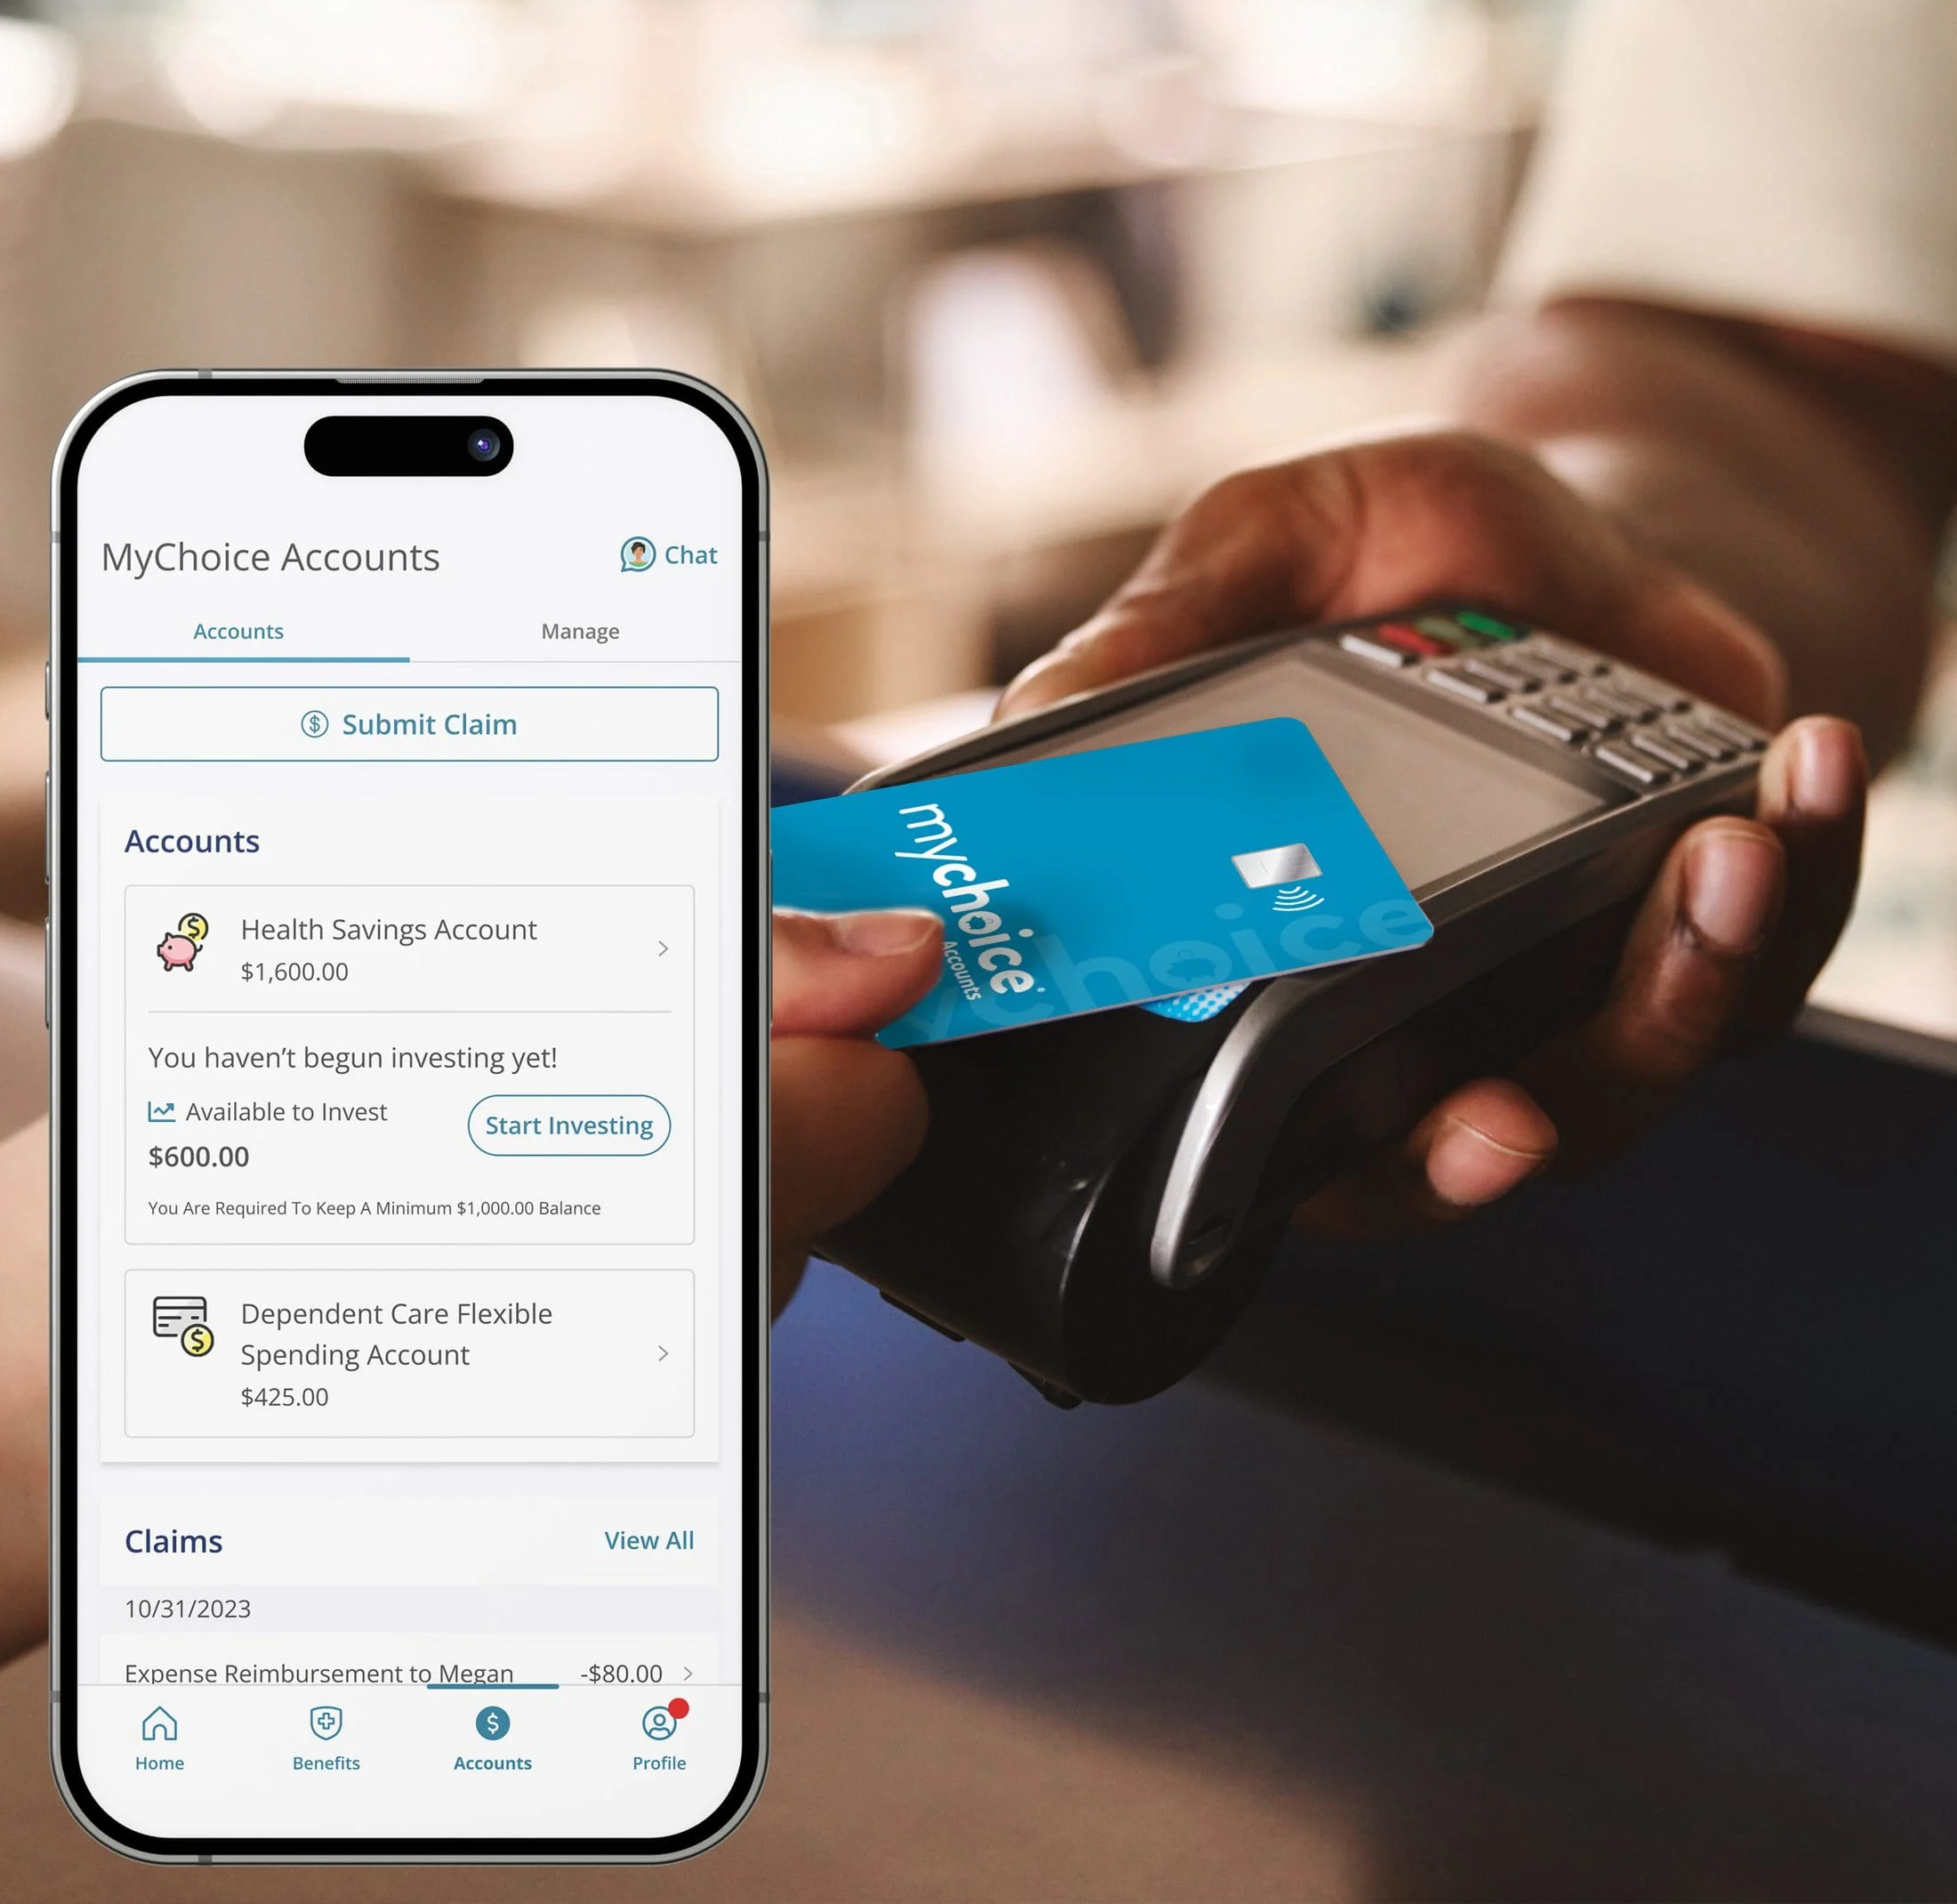
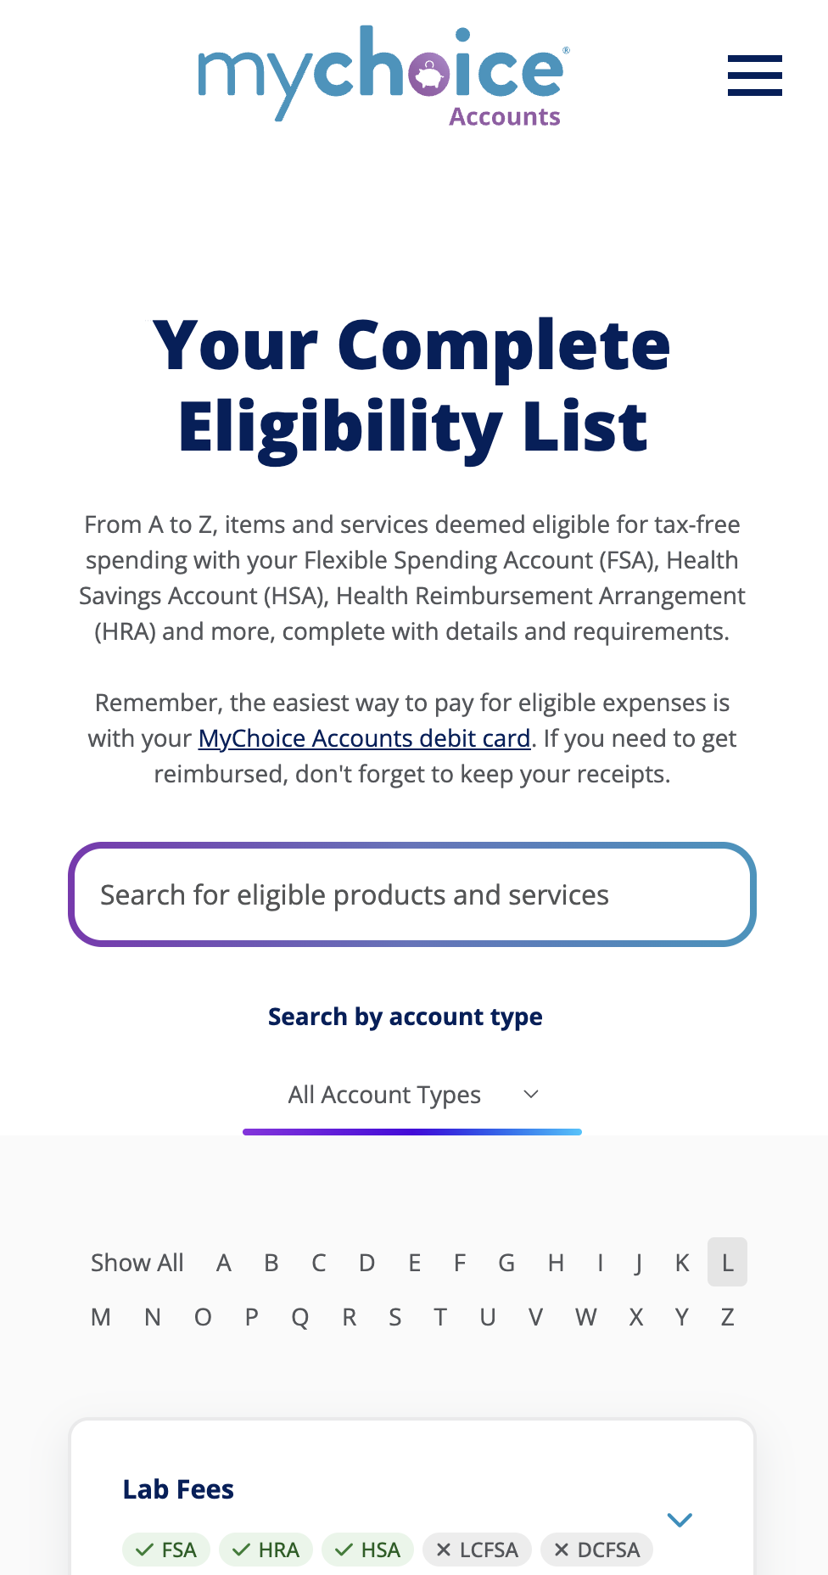
Some of the Hundreds of “Eligible” Expenses:
MEDICAL, DENTAL, VISION, PRESCRIPTION + MORE
  Allergy Medicine
  Blood Pressure Monitoring
  Braces
  Breast Pump
  Contact Lenses
  Copayments (Medical and Prescription)
  Deductible
  Dental Treatment
  Durable Medical Equipment (walkers, crutches, and more)
  Feminine Care Items
  Fertility Treatment
  Hearing Aids
  Insulin and Diabetic Supplies
  Laser Eye Surgery
  Over-the-counter (OTC) treatments
  Pain Medications
  Sunscreen
For even more items—go to mychoiceaccounts.com
Notes:
So as you have heard and seen so far, There are hundreds of uses for your FSA and HSA funds, including medical, dental, vision, and prescription expenses for you, your spouse or your dependents. Here is a sample list of qualified expenses, as deemed by the IRS.
It’s also important to know what expenses are not qualified as well. Examples of some non eligible expenses would be cosmetic procedures, gym memberships, and teeth whiting. More details on eligible and non eligible items are available at your benefits portal.

Slide 7
Health Care FSA

Slide 8

What is a Health Care FSA? Video
Notes:
(in presentation mode, select the video to play video)
Link if video does not play as expected:
https://vimeo.com/455910435/8cea6913ad

Slide 9
What is an FSA?
For members enrolled in the PPO option.
Account Advantages
Tax savings
Multiple uses
Easy to access
Mobile and online access
Member service support
A Health Care Flexible Spending Account (FSA) is an account that allows you to use pre-tax dollars to pay for health care expenses, like medical, dental, vision and prescription expenses.
FSAs can help your budget go further by using pre-tax funds for everyday expenses.
Notes:
The Health Care Flexible Spending account or “FSA” helps you save money through pre-tax payroll contributions. These accounts will let you save on expenses you already have today!
First, we are going to cover some of the important details about the health care FSA.
The FSA pairs with our PPO health plan option (insert more detail if needed).
You never pay taxes on the funds you set aside, and the FSA is easy to spend with your debit card—at the doctor’s office, dentist, pharmacy, eye doctor, and stores.
The easiest way to access your funds and view your account is much like if you use banking services – online in your benefits portal or in the MyChoice mobile app.

Slide 10
How does a Health Care
FSA work?
Contributions
You decide how much to contribute to your account up to the IRS limit.
Maximum annual contributions for Health Care FSA: $3,300.
If your spouse has access to an FSA, they may contribute the maximum amount too.
Contributions are tax free and processed through payroll in equal deductions throughout the year.
A Health Care Flexible Spending Account is a tax-advantaged account that allows you to use pre-tax dollars to pay for medical, dental, vision prescription, and some over-the-counter items.
Notes:
When you enroll, you’ll choose how much money you want to contribute to the FSA, and you will have access to the full amount you elect for Health Care FSA on Jan 1st [or plan year start date].
Currently, Healthcare FSA contributions are limited by the IRS to $3,300 each year. (2026)
The limit is per person; each spouse may contribute up to the limit if you both are employees of [CLIENT NAME] or if your spouse has access to a Healthcare FSA with another employer.
You can only elect the health care FSA during your annual enrollment period – so for example you can’t decide next June to start one up unless you have a life event such as a birth, marriage or divorce.

Slide 11
How does a Health Care FSA work?
Using Your Account
Use the funds for your qualified expenses for you and your family (spouse, eligible dependents).
Total health care FSA election for the year are available when your plan becomes effective on January 1.
Notes:
A simple overview of using your account is that you can use the funds for medical expenses for you and your family – that includes your spouse and eligible dependents… those are dependents that you claim on your tax returns.
Another great feature of the health care FSA is that all of the money you elect for the whole year is available to you on January 1. It’s essentially an advance of your election. You’ll contribute money throughout the year, but you don’t have to wait on those contributions to get access to that full amount you choose. If you have an emergency in January, you could have it covered, depending on how much you elect.

Slide 12
What Happens if I Don’t Use All My Money?
Health Care FSA Funds Grace Period
Your FSA comes equipped with a grace period, meaning you have until March 15 of next year, to exhaust your current plan year’s election.
Spend your entire election between January 1, 2026 – March 15, 2027.
Presenter note: Choose either slide 12 (grace period) or 13 (roll over) depending on your plan design. Hide or delete the one you don’t need. Remove this text box.
Notes:
Your FSA comes with a grace period. That means you get about 2 and a half extra months to use up the prior year’s funds. So, in all, you will get 14 and a half months to use your 2026 FSA amount. You will want to spend it ALL down within that time frame. Anything you don’t spend will go back into the plan administration. This is an IRS provision.
Both your online account and your mobile account will help remind you of your claims submissions and funds use deadlines.

Slide 13
What Happens if I Don’t Use All My Money?
Health Care FSA Funds Rollover
Your FSA allows you to “roll over” up to $660 annually.
Spend down your balance to at least $660 or less by December 31, 2026.
Presenter note: Choose either slide 12 (grace period) or 13 (roll over) depending on your plan design. Hide or delete the one you don’t need. Put in your rollover amount where indicated. Remove this text box.
Notes:
Your FSA comes with a rollover (or carryover) provision. That means you don’t have to spend every nickel next year. You will need to make sure you spend it down to at least $660 (or client-specified rollover maximum). Anything you don’t spend under $660 will roll over into your FSA the next year. We will send you emails to remind you about this feature when it gets closer to your plan year end.

Slide 14
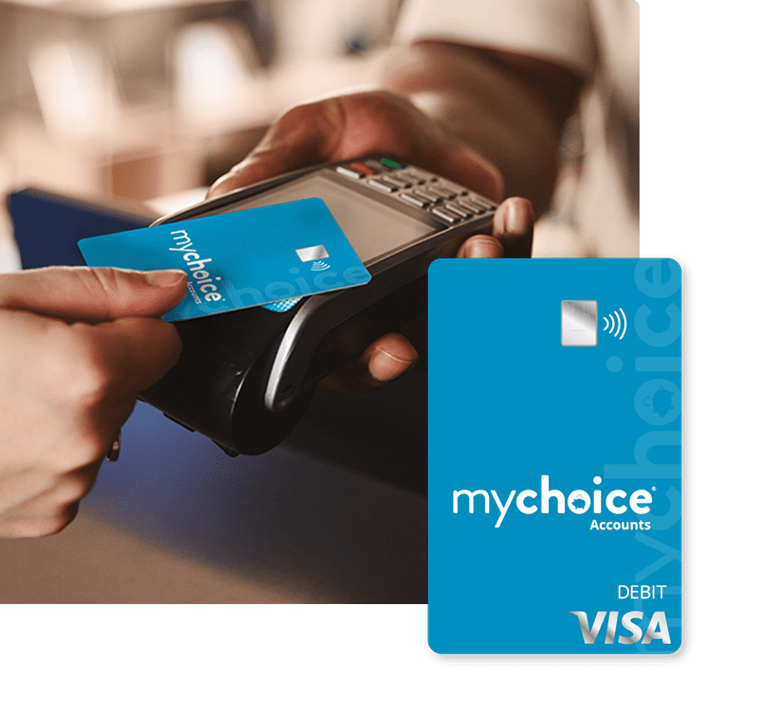
How to Use Your Funds
Swipe your card for eligible items or services. This is the easiest way to use your FSA.
You can also pay for hospital, doctor, dentist, lab bills with your card number, like any other credit card.
Card is programmed to work
at medical providers.
The card can detect eligible
items at most retailers.
You have ONE card for all accounts.
Notes:
More than 90% of the time when you use your FSA card, you will NOT NEED TO SUBMIT anything else. But it is a best practice to keep all receipts. If it’s helpful, take a photo of them and keep in a folder on your phone, so you can just add them to a claim with the mobile app.
NOTE: All accounts you have will be on the one card. You only need one card, etc.

Slide 15
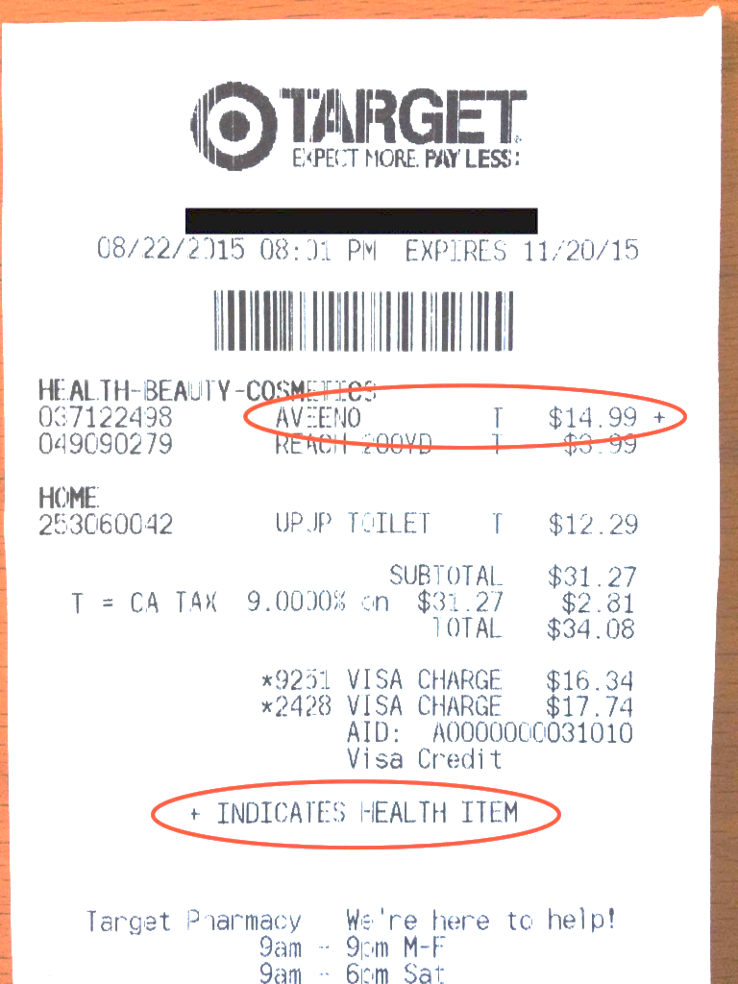

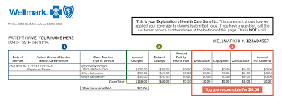
What About Receipts and Documentation?
About 10% of the time when you use the card, we’ll ask for more information.
Why? If you file a claim for reimbursement, we’ll always need documentation.
EOB
The IRS requires MyChoice Accounts and your employer to verify that you are using your funds for eligible items.
Notes:
Discuss different types of documentation they might need – EOBs, receipts, and highlight the pieces of info we usually need to process a claim.
It is an IRS requirement to make sure that FSAs are used according to regulations. This means funds have to be used on those eligible expenses we discussed earlier.
When you use your debit card, you will only need to submit a receipt about 10% of the time, as we can often validate your expense based on where you are or what you purchased.
When we can’t validate it automatically OR you submit a claim for reimbursement online or via the mobile app, we will always need documentation.
The best item to submit is an Explanation of Benefits (or EOB) if it is a provider-related expense. You can also submit an itemized receipt or itemized bill.

Slide 16
What is it You Need again?
For items purchased
online or at a retailer…
Amount paid – if you purchased multiple items, circle the ones that are eligible – should match the card swipe $$
Service/Item – needs to have something to indicate what it is, not just a total or credit card receipt with no listing
Provider name and address – name/address of store or provider
Date of service – within your plan year/incur dates
Person receiving service (if applicable, usually not with OTC purchases)
If it’s something insurance has helped you pay, the EOB will always be the BEST thing to submit.
Notes:
In order to comply with IRS rules, we will want to see the following information on your documentation:
Person who received service
Amount paid for service
Service/Item
Provider name and address
Date of service
Description of service: category and type
Sometimes when you use your card, we might still need documentation. Let’s talk about that next.
Obviously, if you go to Rite Aid and buy items for your household, we will not need the person who received service.

Slide 17
What Happens if I Don’t Submit Documentation?
If we don’t receive the right documentation or substitute documentation (another receipt for eligible services), your FSA could be temporarily suspended, and your card won’t work for that account until you clear the claim.
There are many examples of using your card at an eligible LOCATION, but it might not be for an eligible expense.
Hospital: cosmetic surgery
Dentist: teeth whitening
Eye doctor: non-prescription
sunglasses or color-changing contacts
Mychoiceaccounts.com:
Debit Card Info page has more details.
Notes:
Examples of non-eligible services at eligible locations:
Hospital: cosmetic surgery
Dentist: teeth whitening
Day care: contribution to teacher gift fund
Eye doctor: non-prescription sunglasses or color-changing contacts
Bottom line: The FSA can still save you money. Don’t be intimidated by receipt requirements. Just be sure to get a good receipt for any of your purchases, and use your card any time you can. That will make it much easier. You can order additional cards for your spouse or partner and dependents above age 16. Make sure they know to keep receipts too.
If your card is suspended – edit the claim and add documentation or submit a NEW claim for eligible expenses you’ve paid out of pocket.

Slide 18

Why Enroll? Savings, Savings, Savings!
 | No FSA | With FSA
Annual Pay | $35,000 | $35,000
Pre-tax FSA Contribution | -$0 | -$1,500
Taxable Income | =$35,000 | =$33,500
Federal income and Social Security Taxes | -$7,852 | -$7,362
After-tax dollars spent on eligible expenses | -$1,500 | -$0
Spendable income | =$25,648 | =$26,138
Melissa’s Tax Savings | $0 | $490
How it works:
Assume “Melissa” earns $35,000 a year and has $1,500 in eligible expenses.
*Sample tax savings for a single taxpayer with no dependents; actual savings will vary based on your individual tax situation. Consult a tax professional for more information. This FSA Savings calculator was created by MyChoice Accounts to be illustrative of typical results of typical participants in similar type benefits programs. The accuracy of the results are predicated upon the input provided by the user, and as such, MyChoice Accounts disclaims the accuracy of any results shown. This calculator is intended merely as a planning tool and is not meant as tax or investment advice. Before taking any action based upon the results provided, please consult with a tax consultant or expert.
Notes:
Health Care FSAs can cover medical, dental, vision, prescription and over the counter expenses that you would otherwise pay for using personal funds--potentially saving you hundreds of dollars each year in taxes.
In this example, Melissa contributed $1,500 to her health care FSA. Because her contributions are taken out pre-tax, she does not pay taxes on the money contributed to her FSA, saving her close to $500 this year!
On the left it shows that she was going to spend $1,500 on health care services and items during the year either way. On the right in purple, we see that by setting aside that money in an FSA, she saved nearly $500 because she did not pay taxes on that money.
You’ll also find that FSAs are especially useful when planning for large health care expenses-- like having a baby, getting braces or having laser eye surgery.
We have a calculator that you can complete to see what YOUR savings could be. We’ll have a link to that on our website at mychoiceaccounts.com. Most people are going to find at least a few hundred dollars in savings…that savings can go a long way toward something else.

Slide 19
Health Savings Account
(HSA)

Slide 20

What is an HSA? Video
Notes:
(play video)
Link if video does not play as expected:
https://vimeo.com/462397664/e30d775960

Slide 21

What is an HSA?
For members enrolled in the HDHP (High Deductible Health Plan)
A Health Savings Account (HSA) is an account that allows you to use pre-tax dollars to pay for health care expenses, like medical, dental, vision and prescription expenses. Think of it as a way to cover your deductible and as long-term savings.
MEDICAL EMERGENCY
or RETIREMENT SAVINGS
DEDUCTIBLE $
Account Advantages
HSAs never “expire”
HSAs are “portable”
Tax savings
Multiple uses
Invest funds for growth
Easy to access
Mobile and online access
Member service support
Notes:
A Health Savings Account (HSA) is an account that allows you to use pre-tax dollars to pay for health care expenses, like medical, dental, vision and prescription expenses. Think of it as a way to cover your deductible and as long-term savings.
Account Advantages
HSAs never “expire” – unlike an FSA, which you may also be familiar with, HSAs are NOT “use it or lose it.” They roll over year to year.
HSAs are “portable” – HSAs are your personal savings account, so even if you depart from the organization, you still own the funds and can spend them on eligible services and items.
Tax savings – you set aside your HSA funds pre-tax, and you are not taxed when you spend your funds.
Multiple uses – HSAs can be used for doctor and dental visits, orthodontics, vision expenses, prescriptions, over the counter remedies, and many more uses.
Easy to access -- it’s easy to spend your funds when you need to with your MyChoice Accounts VISA debit card.
Mobile and online access – you can always check your balance and manage your account in your benefits website or the MyChoice benefits app.
Member service support –if you have questions or concerns, you have a member services number to call.

Slide 22
HSA Contributions
You decide how much to contribute to your account up to the IRS limit.
Maximum annual contributions for HSA 2026:
$4,400/year filing single
$8,750/year filing jointly
FREE MONEY
[CLIENT NAME] contributes to the HSA in January and July.
Contributions are tax free and processed through payroll in equal deductions throughout the year. You can change your election amount at any time.
$600/single/year
$1,200/family/year
Notes:
ITEMS IN GREEN ARE CONFIGURABLE AT THE CLIENT LEVEL! Remove text if you do not offer an HSA seed amount. You could enlarge the “money bag” to make it look good.
You decide how much to contribute to your account up to the IRS limit.
Maximum annual contributions for HSA 2026:
$4,400/year filing single
$8,750/year filing jointly
Contributions are tax free and processed through payroll in equal deductions throughout the year. You can change your election amount at any time.

Slide 23
Key differences from FSA:
How does an HSA work?
Option to save and NOT SPEND.
No expiration date.
No receipts or documentation needed (save them for the IRS).
Your savings account “for life” – even if you separate from employer.
Funds available as you make contributions through payroll – you can only spend what you’ve already set aside.
Invest contributions to grow your $ faster.
Open an HSA at any time or change contributions at any time in the year.
Using Your Account
Use the funds for your qualified expenses for you and your family (spouse, eligible dependents).
Notes:
Using Your Account
Use the funds for your qualified expenses for you and
your family (spouse, eligible dependents)
Key differences from FSA:
Option to save and NOT SPEND – you can save and accrue your funds year over year if you don’t need them to pay health care expenses.
No expiration date.
No receipts or documentation needed (save them for the IRS).
Your savings account “for life” – even if you separate from employer.
Funds available as you make contributions through payroll – you can only spend what you’ve already set aside.
Invest contributions to grow your $ faster.
Open an HSA at any time or change contributions at any time in the year.

Slide 24
What Can I do With My HSA?
Spend
Save
Invest
Notes:
HSAs can help your health care budget go further. Think about it as having three functions. Spend, Save, or Invest. So let’s look at each of these functions and find out how to maximize your HSA.

Slide 25
SPEND
Your HSA
Notes:
We’ll start with Spend, as that’s what most people think of when they have an HSA. Sometimes you need to cover medical costs – unexpected expenses or large out-of-pocket costs like braces or physical therapy. Or if your budget gets tight, the HSA is there to help you cover costs. Anything you have to pay out of pocket toward your deductible can be paid with your HSA.

Slide 26
Think About What You Already Cover Out-of-Pocket…
…these are all eligible with HSA funds
Notes:
HSAs cover medical, dental, vision, prescriptions as well as items you buy over the counter such as pain medicine like Advil or Tylenol in the picture, sun screen and even allergy medicine. Again, Think about things like upcoming surgeries…or even if your child needs braces or other orthodontic work.
All of these items are covered with your HSA. So, you will be setting aside your money and saving that 20-30% in taxes every time you need to pay for something like this.

Slide 27
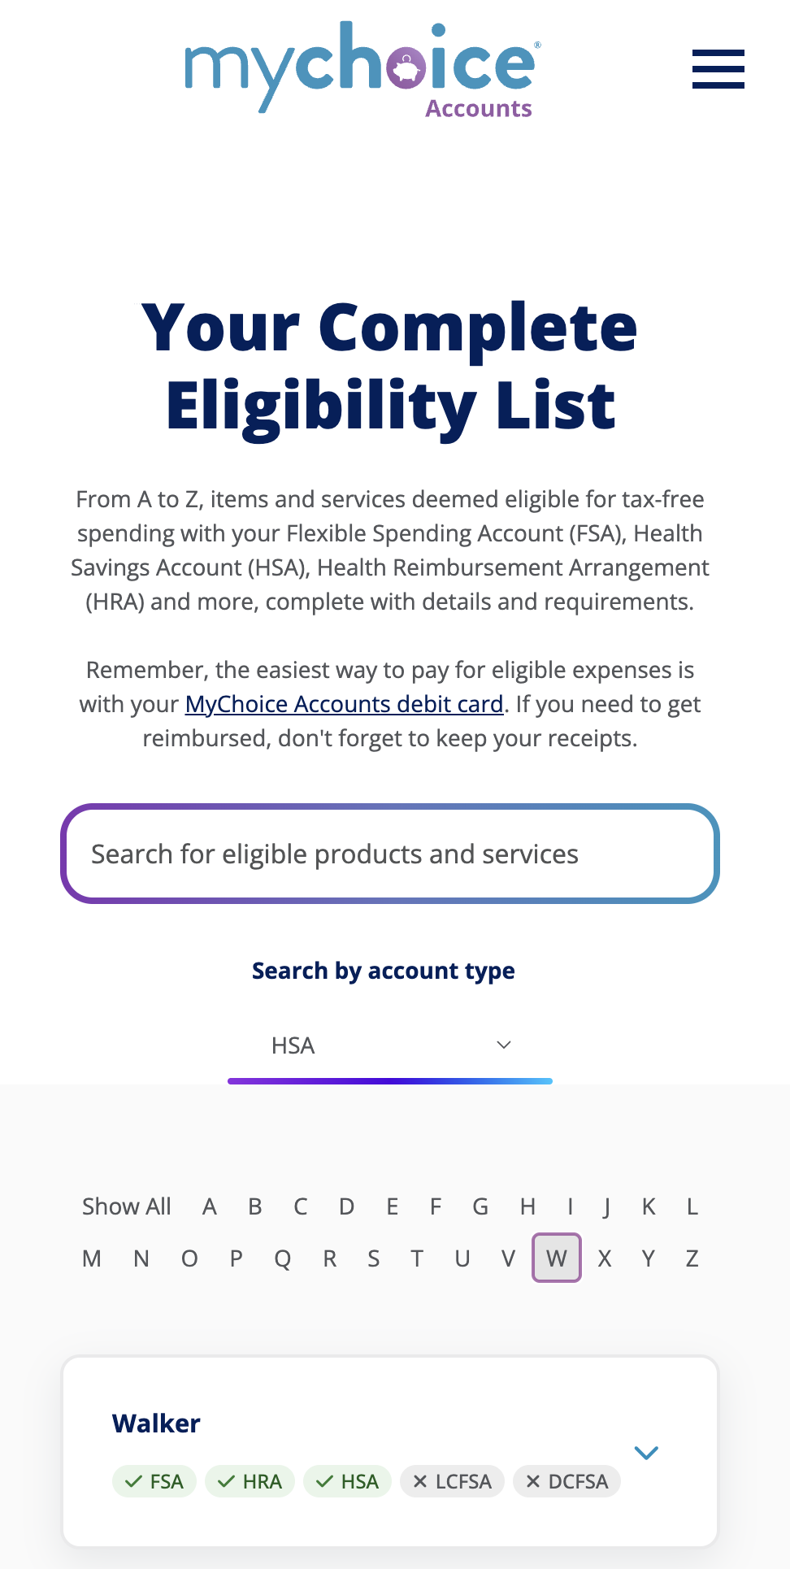
Some of the Hundreds of “Eligible” Expenses:
MEDICAL, DENTAL, VISION, PRESCRIPTION + MORE
  Allergy Medicine
  Blood Pressure Monitoring
  Braces
  Breast Pump
  Contact Lenses
  Copayments (Medical and Prescription)
  Deductible
  Dental Treatment
  Durable Medical Equipment (walkers, crutches, and more)
  Feminine Care Items
  Fertility Treatment
  Hearing Aids
  Insulin and Diabetic Supplies
  Laser Eye Surgery
  Over-the-counter (OTC) treatments
  Pain Medications
  Sunscreen
For even more items—go to mychoiceaccounts.com
Notes:
So as you have heard and seen so far, There are hundreds of uses for your HSA funds, including medical, dental, vision, and prescription expenses for you, your spouse or your dependents. Here is a sample list of qualified expenses, as deemed by the IRS.
It’s also important to know what expenses are not qualified as well. Examples of some non eligible expenses would be cosmetic procedures, gym memberships, and teeth whiting. More details on eligible and non eligible items are available at your benefits portal.
It is your responsibility to know what’s eligible and what’s not, as your HSA does not require receipts. You are essentially attesting that you are using it as intended when you make a transaction. It is advised to keep receipts in case you are audited by the IRS.

Slide 28
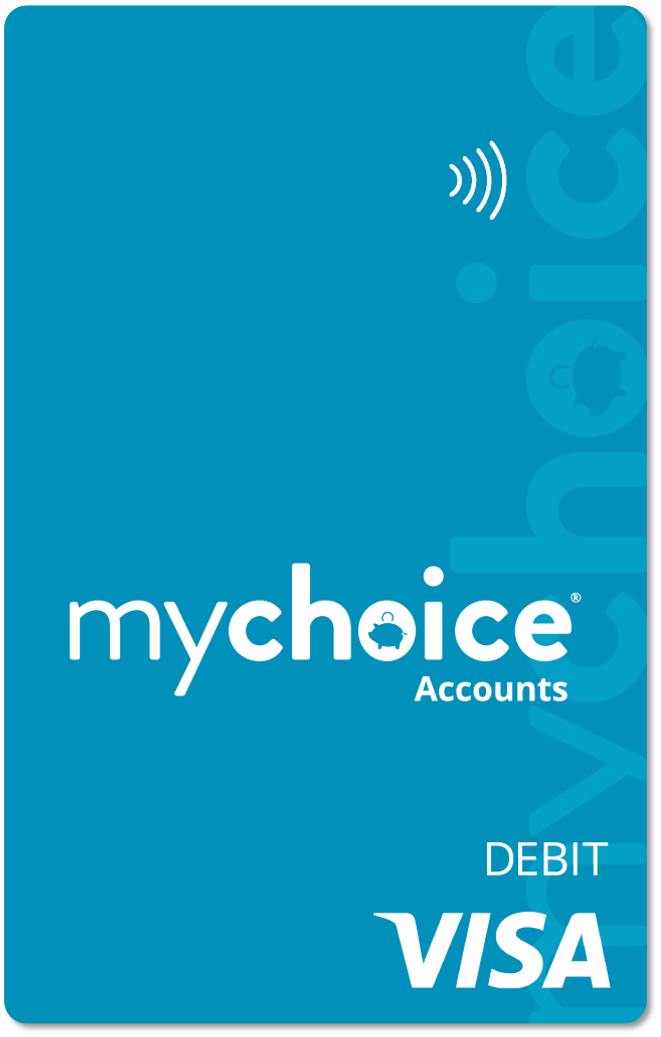
How do I Spend My HSA?
Use your MyChoice Accounts debit card on eligible expenses.
Many stores have medicine, supplies, and other eligible items marked on the price tag.
YOU are responsible for purchasing eligible items. The IRS does not require MyChoice Accounts to verify your HSA spending.
File or take a photo of your receipt for your own safekeeping.
No need to submit receipts or documentation for an HSA.
Notes:
Use your MyChoice Accounts debit card on eligible expenses.
Many stores have medicine, supplies, and other eligible items marked on the price tag.
YOU are responsible for purchasing eligible items. The IRS does not require MyChoice Accounts to verify your HSA spending.
File or take a photo of your receipt for your own safekeeping.
No need to submit receipts or documentation for an HSA.

Slide 29
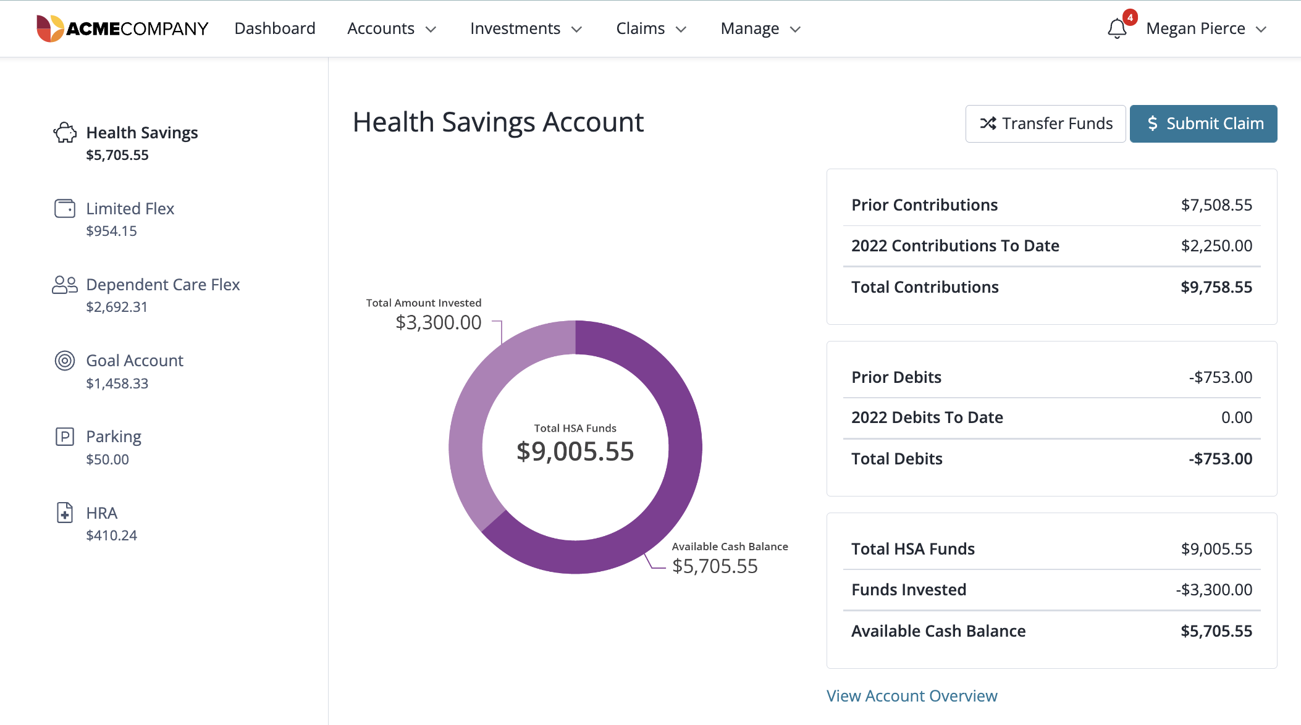
What if I Don’t
Have My card?
You can transfer your HSA funds to your personal bank account or submit claim to receive a paper check when you spend your HSA funds on eligible items and services.
Notes:
If you don’t have your card handy when you need to pay at the provider’s office or store, you can transfer your HSA funds to your personal bank account when you spend them on eligible items and services. This is the easiest and fastest way to access your funds. So, be sure to set up direct deposit and use that Transfer Funds button.
If you don’t want to set up direct deposit, we are still happy to mail you a check. Use the Submit Claim feature to request a mailed reimbursement.

Slide 30


Another way to spend…Limited Purpose FSA
DENTAL/VISION EXPENSES + PREVENTIVE CARE
If you enrolled in a Limited Purpose FSA, you can SPEND that and keep your HSA balance intact.
Make election during annual enrollment.
Spend down your balance or carry over up to $660/year.
Use the same debit card as your HAS.
SOME EMPLOYERS WILL OFFER THE LIMITED PURPOSE FSA. Remove this slide if you do not offer or remove this box to use this slide. Align with grace, carryover, runout info.
Notes:
If you enrolled in a Limited Purpose FSA, you can SPEND that and keep your HSA balance intact. You may only elect this account during annual enrollment each year.
If you have dental or vision expenses, this is a great way to set aside tax-free money. Just like a standard FSA, you’ll want to deplete the funds on an annual basis. If you have signed up for this, use your same debit card. The card is programmed to pull any dental or vision expenses from the limited purpose FSA first. And remember, you have access to your FULL FSA at the beginning of each year, so you can go ahead and purchase your contacts, glasses, or make orthodontist payments as early as January.

Slide 31
SAVE
Your HSA

Slide 32
The S is for Savings
HSAs GROW!
Your HSA funds never “expire.”
HSAs have a small percentage of growth just like a savings account.
You can hold your HSA funds year over year.
If you leave your current employer, your HSA goes “with you.”
You may roll over funds to a new employer’s HSA or continue to hold or spend your HSA funds on eligible expenses.
Notes:
This is a savings account, again, as opposed to an FSA, which is designed to SPEND. HSAs are most effective when you let them build over time. We’ll get to what to do when you need to use the funds in a few minutes, but we started with savings because we’d love for you to think of your HSA primarily as a savings tool.
Your HSA funds never “expire.”
HSAs have a small percentage of growth just like a savings account.
You can hold your HSA funds year over year.
If you leave your current employer, your HSA goes “with you.”
You may roll over funds to a new employer’s HSA or continue to hold or spend your HSA funds on eligible expenses.

Slide 33

The S is for Savings
If possible, think of your HSA as one of your retirement accounts that you can use before retirement if needed.
WHY?
Notes:
If possible, think of your HSA as one of your retirement accounts that you can use before retirement if needed.
WHY?

Slide 34

Cost of Health Care in Retirement
The current estimate for what a retired person may need for health care is approximately $165,000 saved (after tax) to cover health care expenses in retirement.
For a couple, that cost increases to $330,000.
~ Fidelity Retiree Health Care Cost Estimate
Notes:
Some of you may be 25 years away from retirement and feeling the pinch of inflation right now. Why consider your HSA as a long-term savings? One thing we know is that health care expenses continue to increase year over year. Having some tax-free savings to help cover these costs is just as smart as putting money away in a 401(k).
People don’t tend to get healthier as they age. They will tend to need more care, and Medicare doesn’t cover everything. You can use your HSA to cover that gap between Medicare and additional Medicare options, and other health care expenses in retirement.
Source: https://newsroom.fidelity.com/pressreleases/fidelity-investments--releases-2024-retiree-health-care-cost-estimate-as-americans-seek-clarity-arou/s/7322cc17-0b90-46c4-ba49-38d6e91c3961

Slide 35

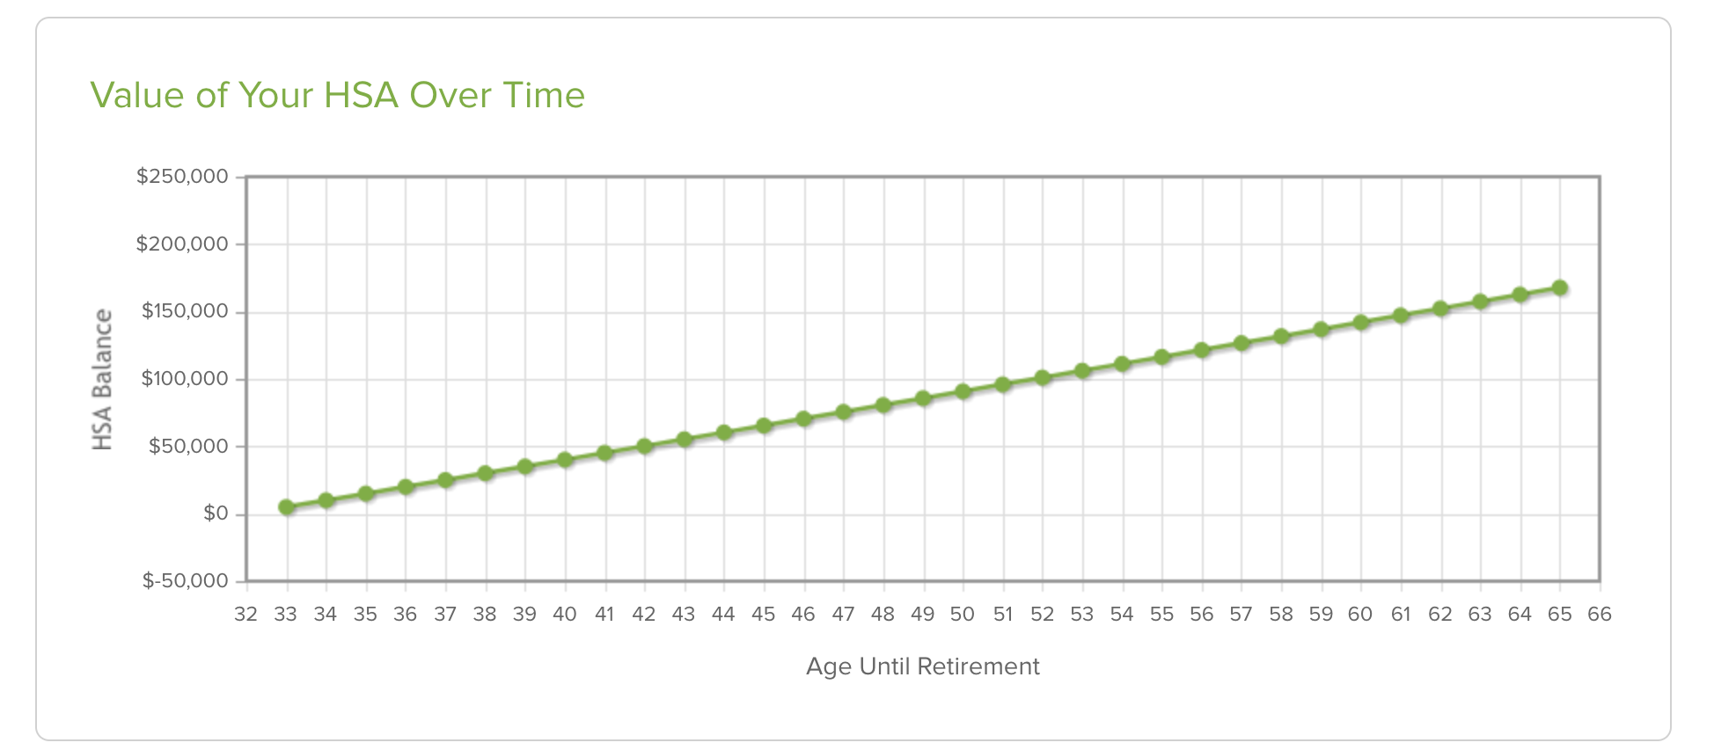
Nest Egg
Age 65
$167,835
Age 50
$90,859
Age 42
$50,275
Ming sets aside the $5,000 per year in her HSA, using about $1,000 annually for various medical expenses. She starts contributing at age 32 and invests the money she’s not actively using. Assuming a $400/year employer contribution.
$4000/year savings at .1% interest growth
$5,000 over 26 paychecks = $192.30 per check
Notes:
Again, this is a savings account, so it will grow with a very modest percentage of interest over time. We have our sample member here who contributes $5,000 a year for her family HSA. She could contribute up to $8,550 a year in 2025, and those contribution upper limits will continue to grow, but let’s say she feels comfortable at just under $200 per paycheck.
We see that if she saves and contributes consistently, spending only about $1,000 per year on average, she still has about $167,000 upon retirement.
To reconfigure this chart based on an employer’s contribution, go to:
https://hsastore.com/hsa-tax-savings-calculator?a_aid=5bf468aa5c776&utm_source=Businessolver&utm_medium=TPA+Public+Link+Cal&utm_campaign=TPA+Partner

Slide 36

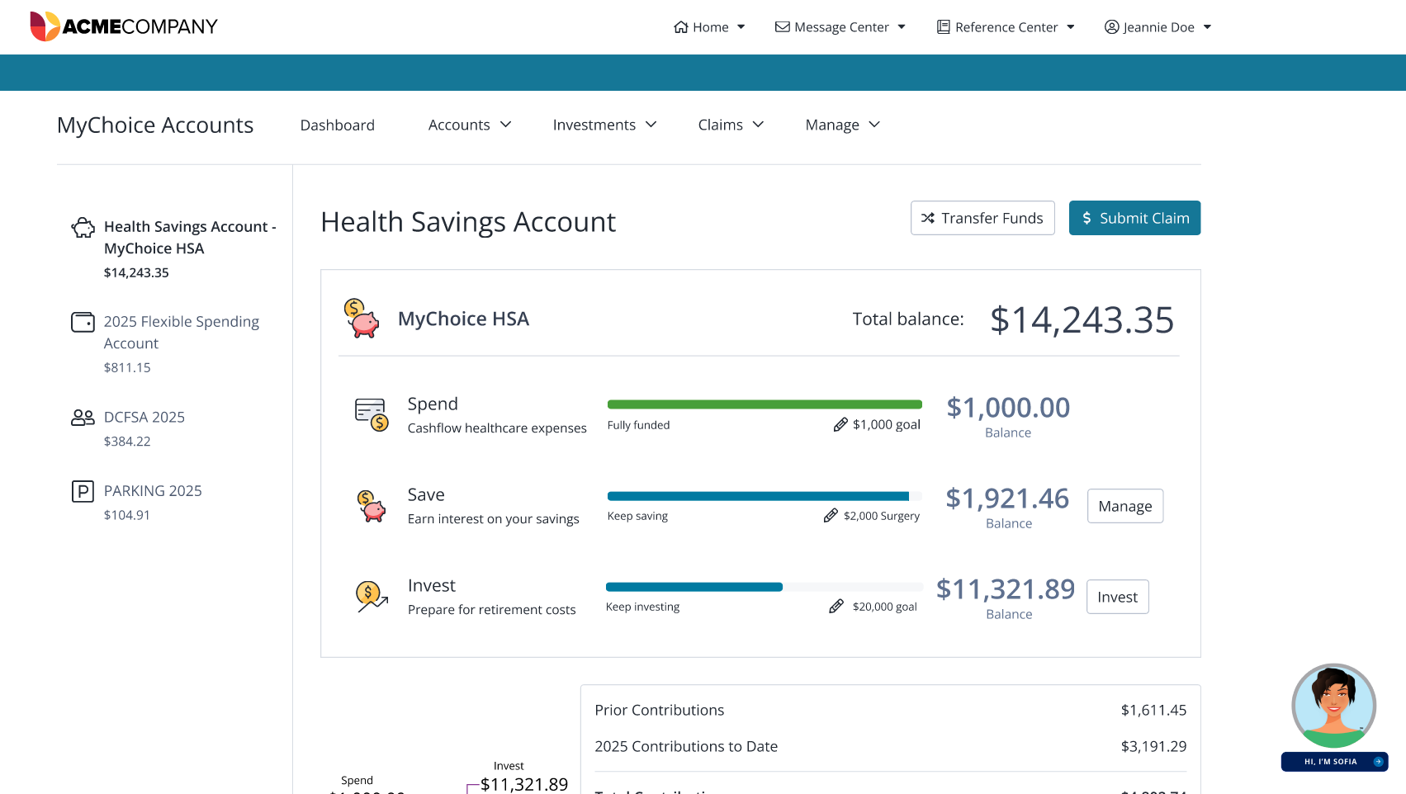
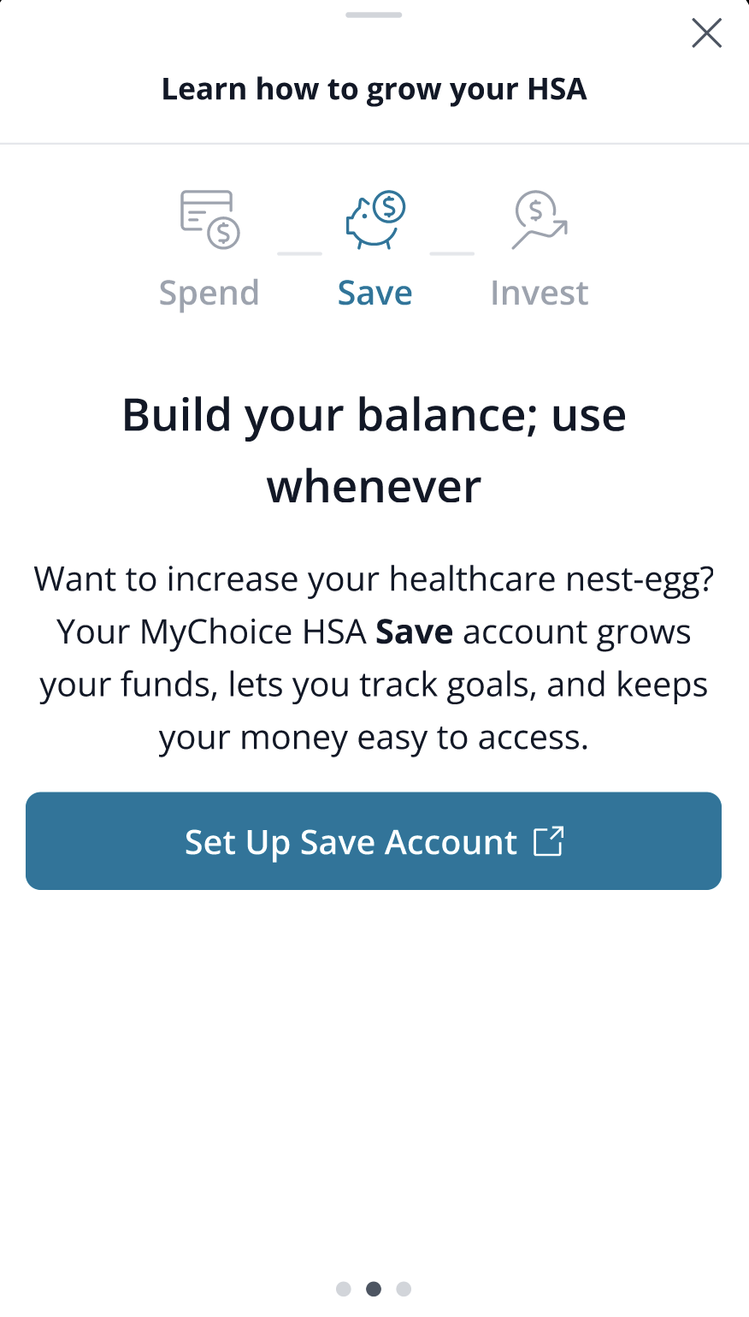
Save…with a money market account
Your HSA has a special Save feature
One way to help you save is our SAVE feature.
It’s a money market fund designed to help you grow your funds for a specific goal or just set it aside for the future.
It works much like a high-yield savings account within your HSA.
Notes:
One way to help you save is our SAVE feature.
It’s a money market fund designed to help you grow your funds for a specific goal or just set it aside for the future.
It works much like a high-yield savings account within your HSA.
You can set it up to pull in future contributions automatically with the auto-sweep function.
This is a low-risk and medium return option if you’d like to take advantage of it for some of your funds. You’ll still need to keep [[$1,000]] in your Spend category.

Slide 37
INVEST
Your HSA
Notes:
Here’s where you really start to see people drop out, so hang with me. Your HSA also comes with a special feature that FSAs definitely don’t have. Investments…

Slide 38
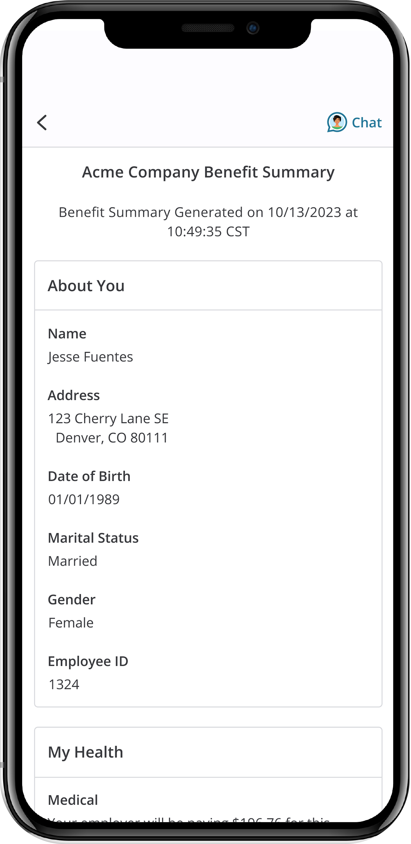
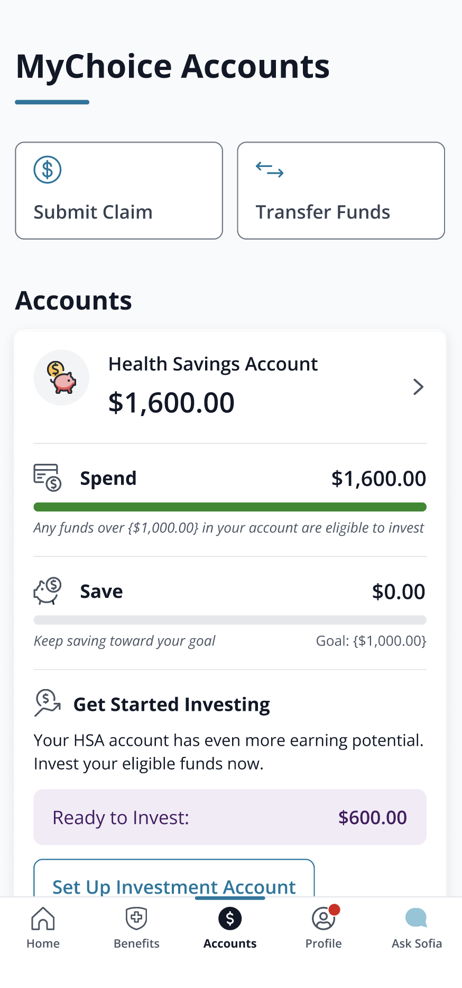
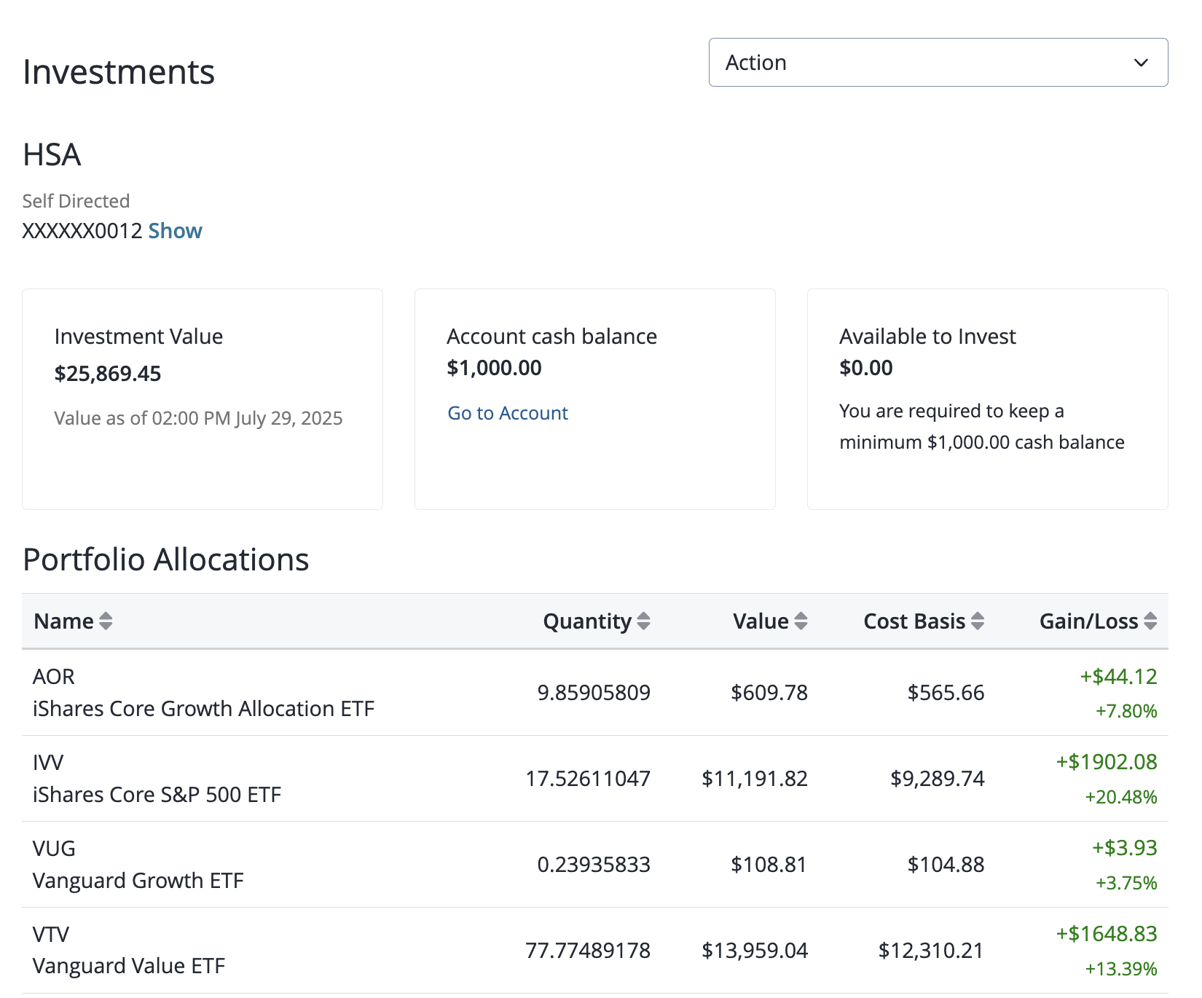
Another option for HSA growth: Invest!
Choose from a variety of exchange-traded funds (ETFs).
Commit as much or as little as you’re comfortable with.
Just keep at least {$1,000} in your Spend category to cover emergencies or short-term health costs.
Higher risk (stock market investments); higher growth potential
All investment funds are subject to stock market fluctuations. You can close your investment account at any time.
Notes:
With an HSA, you also have the capability to invest in a line-up of exchange-traded funds, or ETFs to help you grow your HSA.
Just like the Save category, this is a way to help you set aside funds and let them grow over a longer term.

Slide 39
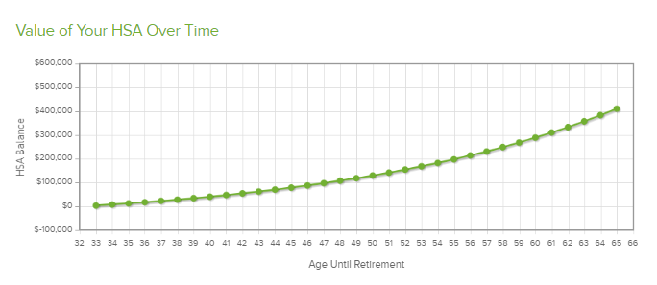
Invest, and That Nest Egg Really Grows!
Age 65
$454,009
Age 50
$144,145
Age 42
$61,475
Ming sets aside the $5,000 per year in her HSA, using about $1,000 annually for various medical expenses. She starts contributing at age 32 and invests the money she’s not actively using. Assuming a $400/year employer contribution.
$4000/year savings at 6% investment growth
$5,000 over 26 paychecks = $192.30 per check
Notes:
Let’s go back to our friend, Ming.
Looking at the exact same set-up here, Ming is still contributing about $5,000 a year for her family HSA. With a modest 6% growth, and that same contribution rate of just under $200 per pay period…Ming can have more than $567,000 available when she turns 65. Let’s look at that difference more closely…
To reconfigure this chart based on an employer’s contribution, go to:
https://hsastore.com/hsa-tax-savings-calculator?a_aid=5bf468aa5c776&utm_source=Businessolver&utm_medium=TPA+Public+Link+Cal&utm_campaign=TPA+Partner

Slide 40
Which One Works Better?
Age 65
Saving only: $167,835
Age 65
Investing:
$454,009
Investing =
$286,174 more!
Notes:
So looking at the savings-only method, there’s nothing wrong with setting aside more than $160,000 for health care costs. That’s still a great savings.
But when you compare it to the investing balance that Ming COULD attain, it’s a huge difference.
Of course, we have to disclaimer a bit, saying that we obviously don’t control the stock market, and some stocks are going to grow more than others.
However, the investment options we provide is a very curated and narrow list that’s been selected for relatively good returns. You can review all the specifications for each investment option and look at the rate of return over 5 and 10 year when you’re selecting your investments.

Slide 41
Investing is Easy
Notes:
Sometimes people are intimidated by investing. You do not need a finance degree or special skills to invest your funds. Once you have at least $1,000 in your account, you can begin investing. Then, we’d recommend keeping about $1,000 free for unexpected expenses. So, keep about $1,000 uninvested and ready to use if you need to make an ER payment or buy a prescription. There is a button on your MyChoice Accounts HSA that will take you into the investing options. MyChoice Accounts cannot provide you with financial advice, but if you get stuck in this process, we can help you navigate the screens.
Remember – the Save category is a money market fund that yields a 3-5% dividend and is lower risk. The invest category is investing in the stock market using ETFs, so slightly higher risk, but potential for 6 – 12% returns, depending on the market fluctuations. You can participate in either option or both.

Slide 42
Dependent Care FSA

Slide 43
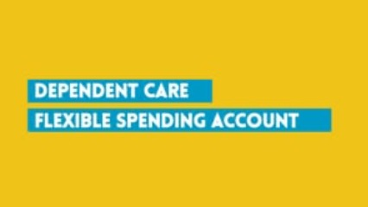
What is a Dependent Care FSA?
Notes:
(click graphic to play video)
Link if video does not play as expected: https://vimeo.com/463053043/21307266ce

Slide 44

What is a DCFSA Plan?
Contributions
You may contribute up to $7,500 to your account ($7,500 per calendar year if single or married filing jointly, $3,750 if married filing separately).
Contributions are tax free.
Using Your Account
Use the funds for child or dependent care while you are at work – typical expenses include day care, before and after school care. Funds become available for use as you contribute them.
Funds Forfeiture
Unused amounts at year-end are NOT rolled over to the next plan year.
A DCFSA Plan is a tax-advantaged account that allows you to use pre-tax dollars to pay for eligible child and elder care while you work.
Notes:
Another type of account you may also choose is a Dependent Care Account Plan or “DCFSA,” This account covers dependent and elder care expenses – like daycare or elder nursing care while you work. You may elect up to $7,500 per year if you have these expenses. Just like the health care FSA, these contributions are all tax-free, which ultimately saves you 20-30% on your final cost of childcare.
Unfortunately, DCFSA funds do not roll over. Per IRS regulations, the rollover feature is limited to Health FSAs; Dependent Care FSA funds may not be rolled over and will expire on December 31 each year. Again, You may elect up to $7,500 per year.

Slide 45
To be reimbursed through your Dependent Care Account Plan for child and dependent day care services, you must meet the following conditions:
The childcare or elder care costs must be for time that you or you and your spouse are working or looking for work, in full-time school, or if care if for an adult – the adult must be physically or mentally incapable of self-care.
You can’t use the DCFSA to pay someone who is your dependent on your federal tax return or to your child who is under age 19. For example, you cannot pay your oldest child to baby-sit your toddler and get reimbursed through this plan.
Am I Eligible for This?
Notes:
There are some eligibility requirements.
The childcare or elder care costs must be for time that you or you and your spouse are working or looking for work, in full-time school, or if care is for an adult – the adult must be physically or mentally incapable of self-care.
You can’t use the DCFSA to pay someone who is your dependent on your federal tax return or to your child who is under age 19. For example, you cannot pay your oldest child to baby-sit your toddler and get reimbursed through this plan.

Slide 46


How Can I Use the DCFSA Plan?
Expenses for DCFSA Plan include
Before school or after school care (other than tuition expenses)
Licensed day care centers
Nursery schools or pre-schools
Placement fees for dependent
care providers, such as au pairs
Childcare at a day camp, nursery
school, or by a private sitter
Summer or holiday day camps
Late pick-up fees
Custodial care for dependent adults
Care of an incapacitated adult at least 8 hours a day, if adult lives with you
Notes:
Here is a list of qualified dependent care expenses. Included on this list are expenses such as Pre-school, day care, camps, as well as before and after school care.
Expenses that you CAN’T USE the DCFSA Plan for are: Expenses for children 13 and older, educational expenses like private school tuition, expenses for food, clothing, sports lessons, field trips as well as overnight camp expenses
It is important to know what is and what is not qualified. You can see in more details at your FSA enrollment website.

Slide 47

Paying for Care
Use your MyChoice Accounts debit card to pay qualified child or elder care providers.
Or pay out of pocket and get reimbursed.
Submit your claims or documentation online or through the MyChoice benefits app.
Always submit your documentation for dependent care expenses, so we can approve them, per the IRS.
Instructions to set up a recurring reimbursements are available at MyChoiceAccounts.com on the Dependent Care page.
If you do not offer a carded dependent care account, remove the first bullet point..
Notes:
Use your MyChoice Accounts debit card to pay qualified child or elder care providers. (((CARDED PLANS ONLY))))
Or pay out of pocket and get reimbursed.
Submit your claims or documentation online or through the MyChoice benefits app.
Always submit your documentation for dependent care expenses, so we can approve them, per the IRS.
Instructions to set up a recurring reimbursements are available at MyChoiceAccounts.com on the Dependent Care page.

Slide 48
Commuter Benefits

Slide 49

What are commuter benefits?
Notes:
(click on the graphic to play video)
Video includes information about BOTH transit and parking options.
Link if the video does play as expected:
https://vimeo.com/467983925/d2d766ae2a

Slide 50

Commuter Benefits
Pre-tax Benefits for Parking and/or Transit
Set aside pre-tax funds for parking expenses (parking at or near your place of work).
Or Transit expenses, any toll or rider expense related to your commute to work that covers costs for:
Train
Subway/Metro
Bus
Ferry
Vanpool service
Notes:
If you pay for parking at or near your office, you can set aside pre-tax funds to help you cover those expenses.
Also, you can save on gas money and help the planet by taking transit – which includes trains, buses, subway, ferry, a vanpool service

Slide 51


How Do Commuter Benefits Work?
Set aside up to $325/month for parking, transit, or both.
Set aside what you think you will USE each month.
Use your MyChoice Accounts debit card to pay at parking kiosks or to purchase transit fare/passes or pay/reload on transit apps.
IRS rules do not allow reimbursement for transit costs paid out of pocket—use your card!
Change your election at any time based on your current commuting status.
Notes:
Set aside up to $325/month for parking, transit, or both.
Set aside what you think you will USE each month.
Use your MyChoice Accounts debit card to pay at parking kiosks or to purchase transit fare/passes or pay/reload on transit apps.
IRS rules do not allow reimbursement for transit costs paid out of pocket—use your card!
Change your election at any time based on your current commuting status.
Note: This is an account that you do not want to let accrue a lot of funds. You should be spending what you’re setting aside, since you can’t take these funds with you if you leave your organization. If your commuting expenses have changed, you should update your election amount.

Slide 52
Accessing Your Accounts
Notes:
{use for all account types}

Slide 53
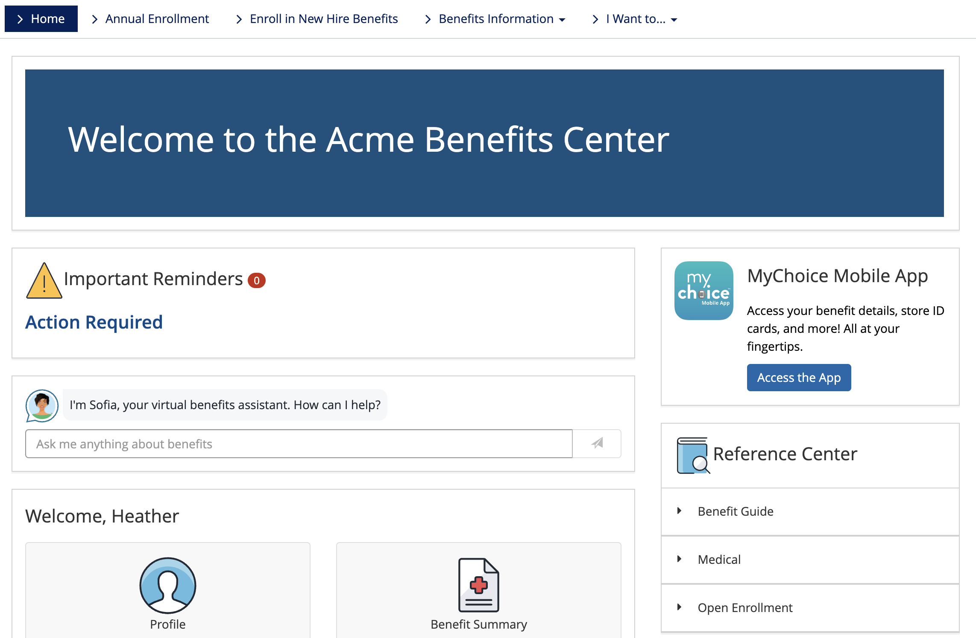
Where Can I Learn More?
Online portal or MyChoice benefits app
Sofia
Videos
FAQ
Deadlines
Calculator links
Member services
www.[CLIENT NAME]WEBSITE
Notes:
Enrolled employees have access to an online portal, an online one-stop-shop for account information and health education tools. In here, you can view account balance and transactions, submit and view claims, reimbursement requests, manage personal and direct deposit bank information and manage your spending debit card.
This website where you can go to enroll and get more information will be the same one that you go to for viewing your account. If you are a new enrollee, your account information will be available on January 1.

Slide 54
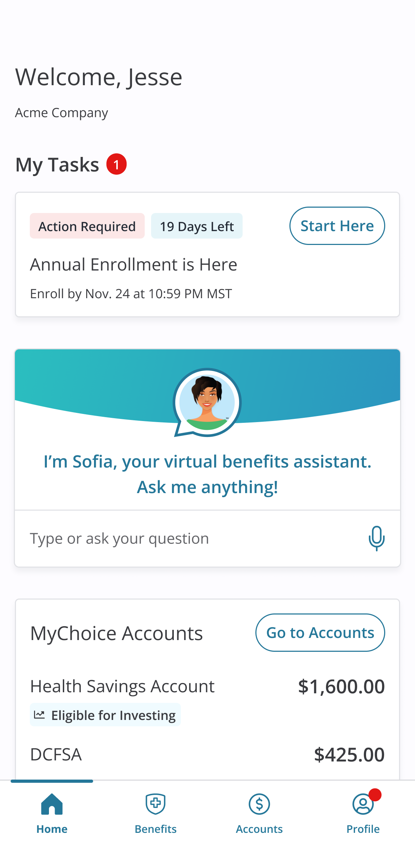



Is There an App For That?
MyChoice benefits app
  Available for Android and iOS devices
  Account balance, alerts and transaction history
  New reimbursement requests
  Tap to call Customer Service
  Upload claim documentation with
  your device’s camera
  Pay a provider
  Add a bank account for direct deposit
  Report a lost/stolen card, order extra card
  HSA Investments
Notes:
The MyChoice benefits app gives you a quick and easy way to access your account on the go. Just download from your app store and you’ll have a secure and simple way to check your account and make payment requests.
The best part about the mobile app- you can take a picture of your receipts and upload them directly to your account. This make documentation requests fast and hassle-free.
It’s the same user name and password as you use for your benefits website online. If you access your benefits website through a company page or SSO, you’ll need to log in to your online site and scan the QR code on your home screen to download and log you into the app.

Slide 55
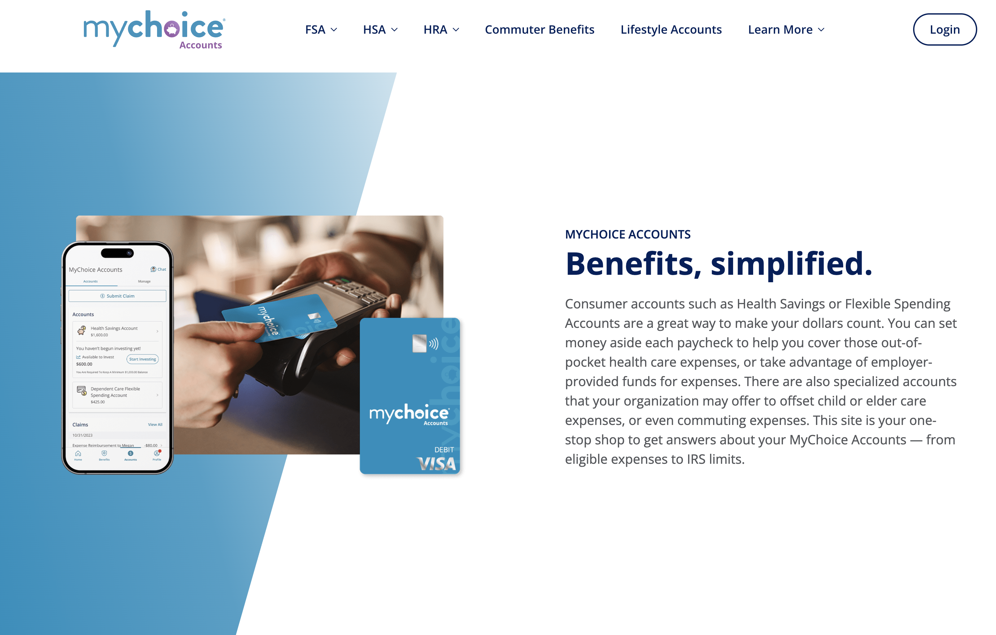
MyChoiceAccounts.com
Resources for Members
General Info on all accounts
FAQs
Savings calculators – to help you select your contribution amount
Videos
Eligible Expense lists/lookup
Coupons for FSA Store and HSA Store
Forms for manual claims submissions or other account activities
Notes:
If you’d like a refresher on anything we covered today, check out our public website at MyChoice Accounts dot com. Here you can watch short explainer videos and see FAQs about the various account types. There are also comprehensive, searchable lists where you can see which items are eligible. Look through the participants and resources tabs for more information.

Slide 56
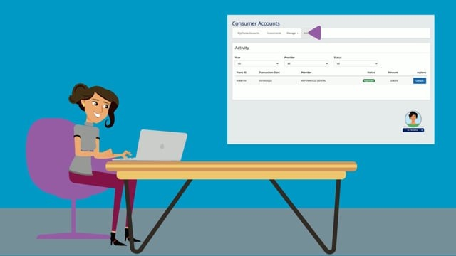
Using Your Accounts
Notes:
Click to play the video.
Video link if playing through the powerpoint doesn’t work as expected:
https://vimeo.com/461994152/c0c07669a0

Slide 57
Questions?
Notes:
{use for all account types}

Slide 58


