Slide 1
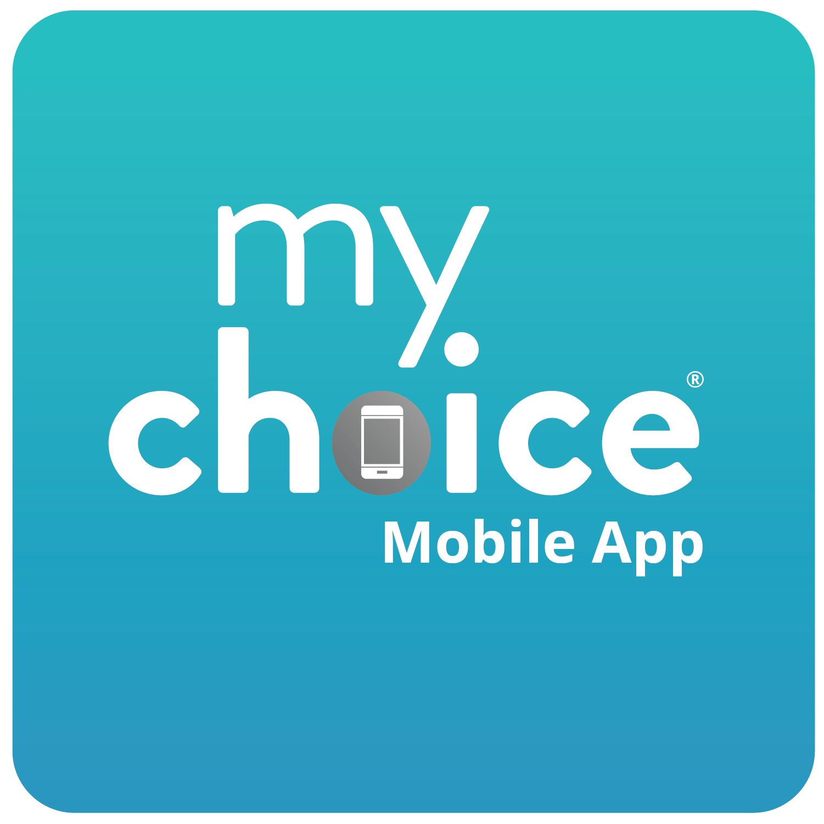
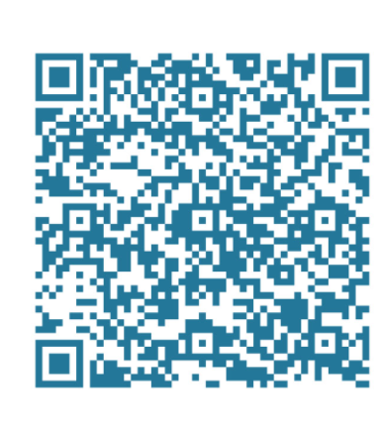
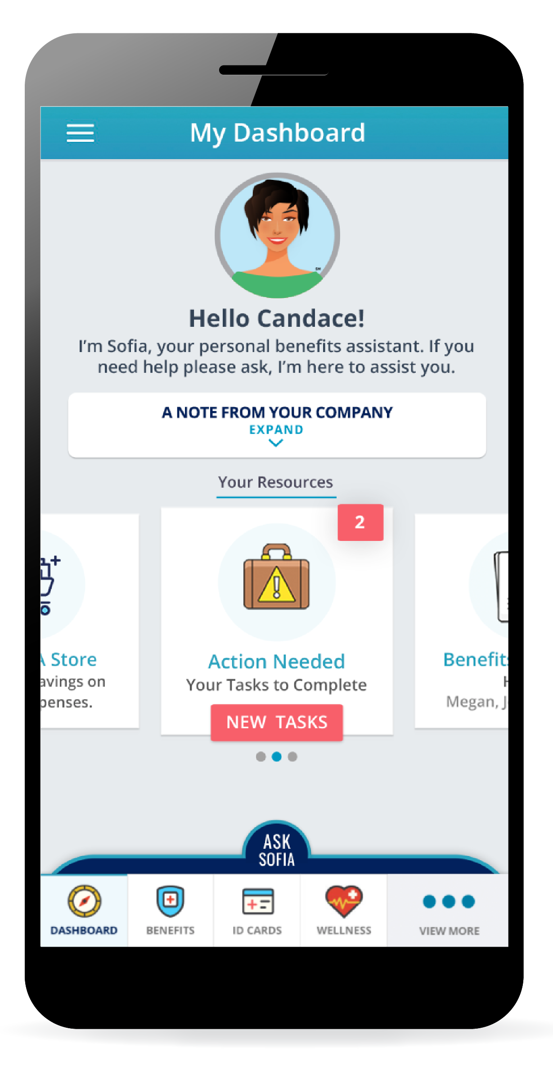
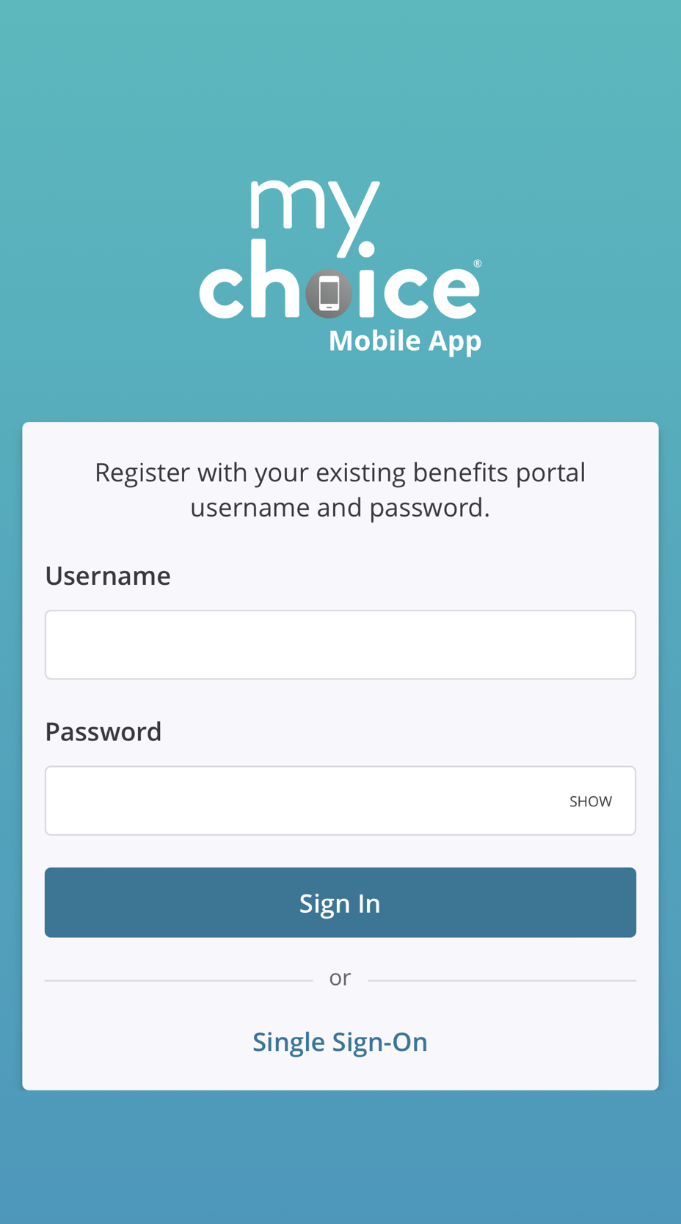
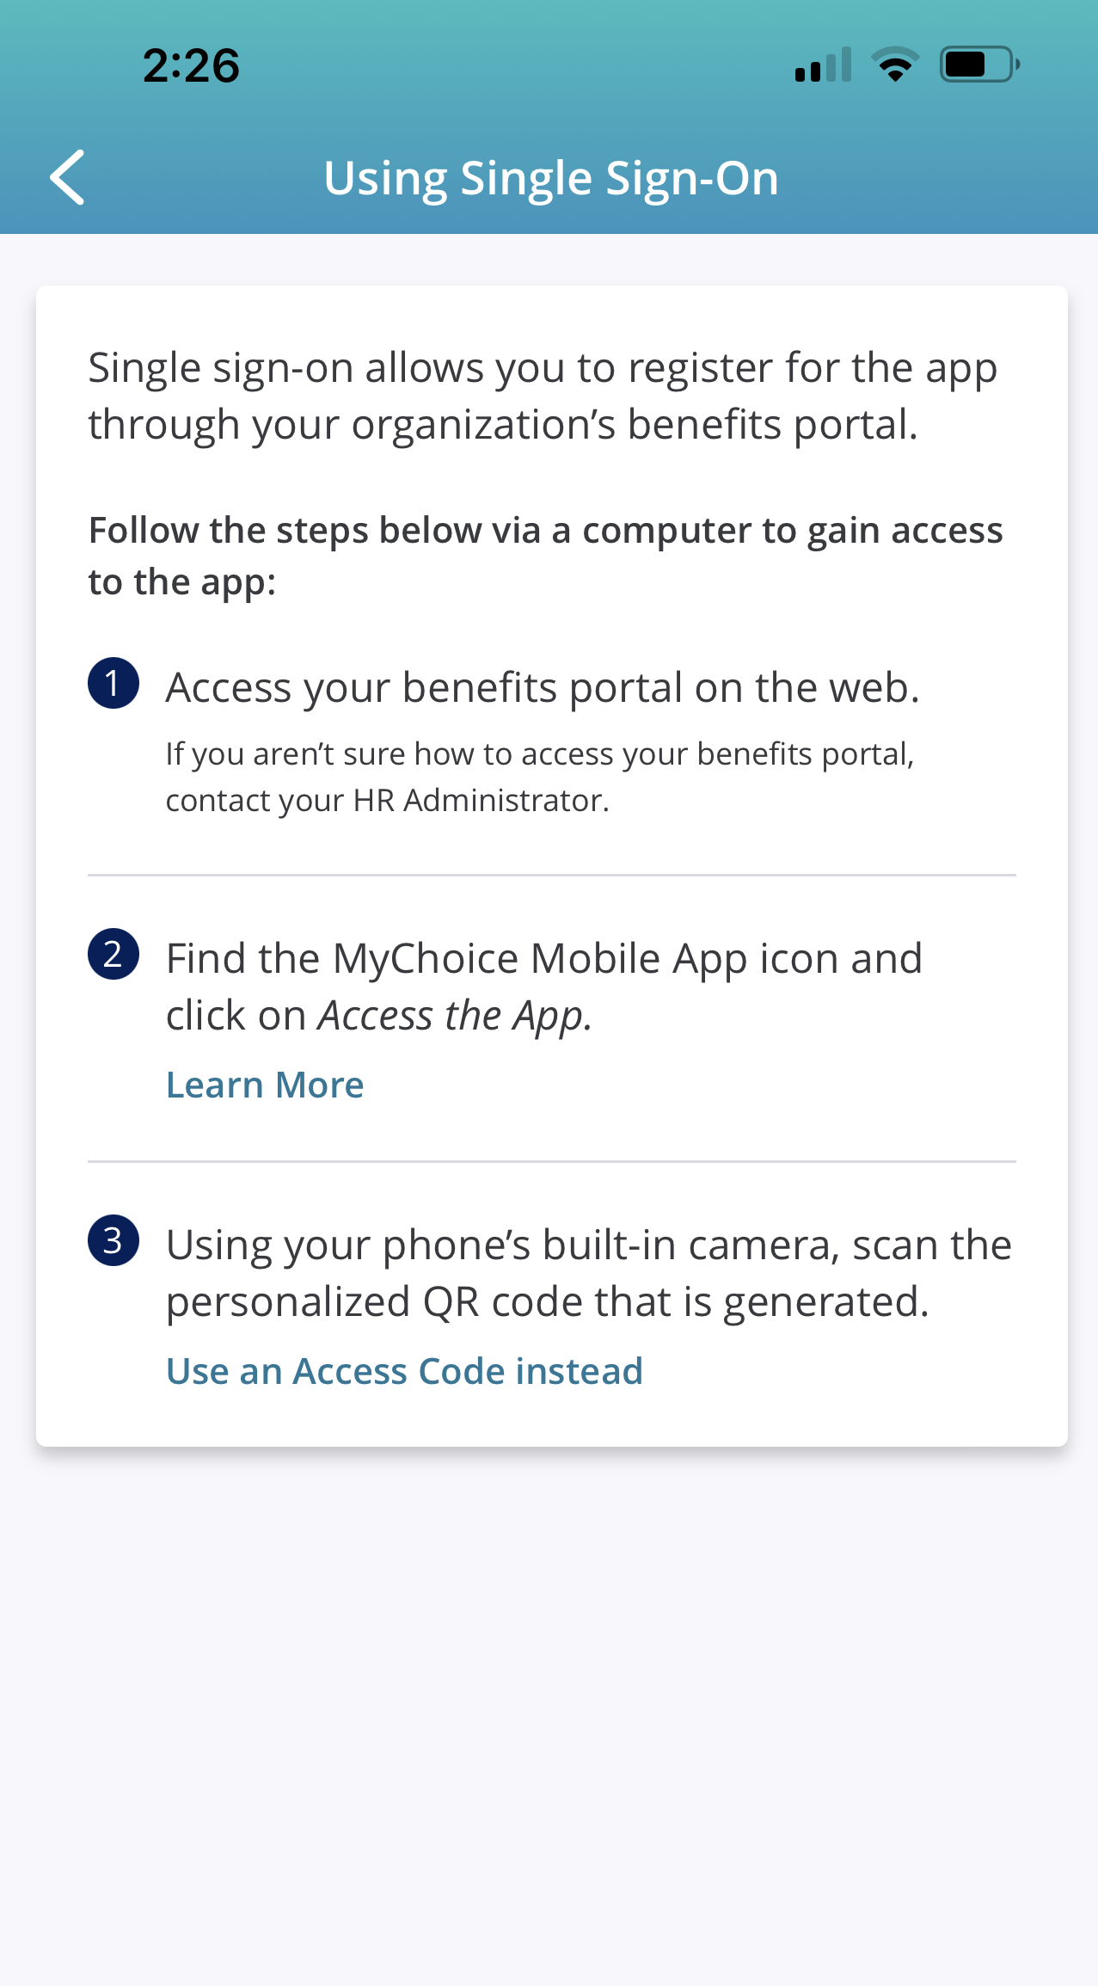
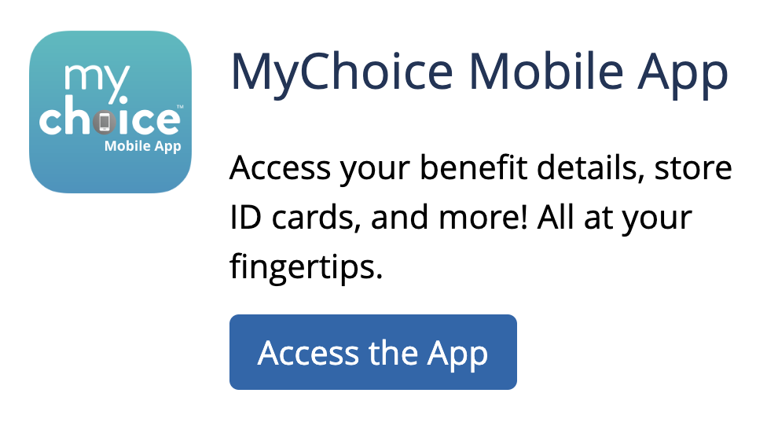
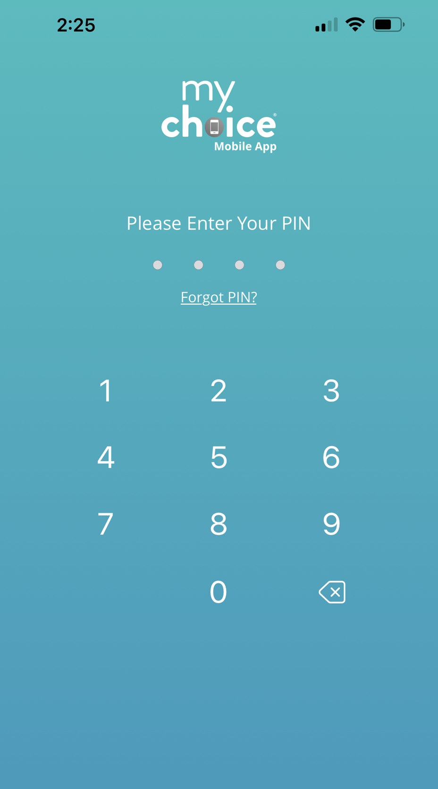
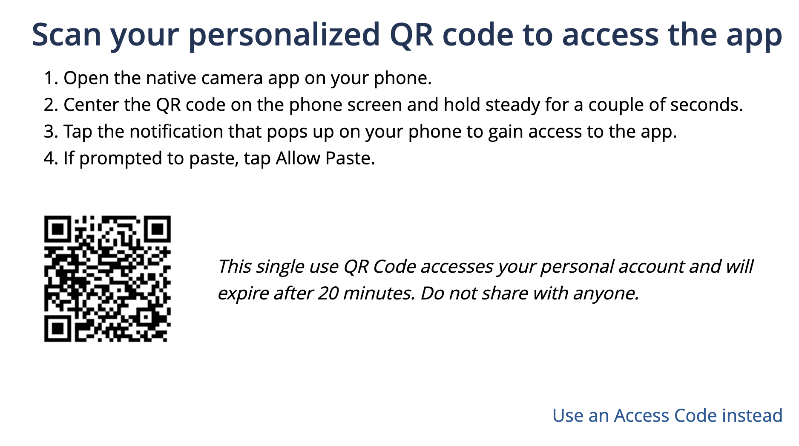
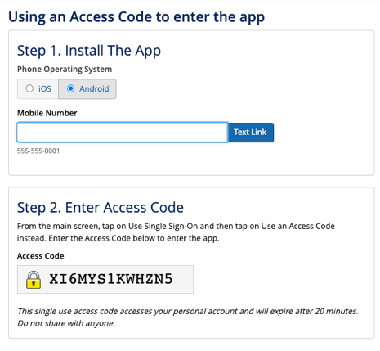
MyChoice® Benefits App
Your Logo Here
GET THE APP
Scan the QR Code:
Open your mobile device and point your camera at the QR code to the right. Touch the pop-up website on your screen.
Instantly Download the free app from your device’s store.
Log in using your MyChoice Accounts username and password, and click Sign In.
To access the app via Single Sign-On, log in to your accounts portal.
Download from MyChoice Accounts online:
Log in to www.benefitsolver.com using your username and password.
Click the Access the App button. A pop-up window will give you the following options:
Scan your personalized QR code with your phone’s camera to open your device’s app store and download the app.
Use an Access Code Instead: Select your phone’s operating system (iOS/Apple or Android), enter your mobile number, and click the blue Text Link button. You will receive a text message on your device to download the app. Enter your time-sensitive Access Code in your portal.
Answer a few security questions and set your 4-digit PIN.
Log in using your PIN.
Forgot your PIN?
Click the link, answer your security question(s), and provide the multi-factor authentication code to reset your mobile app account.

Slide 2
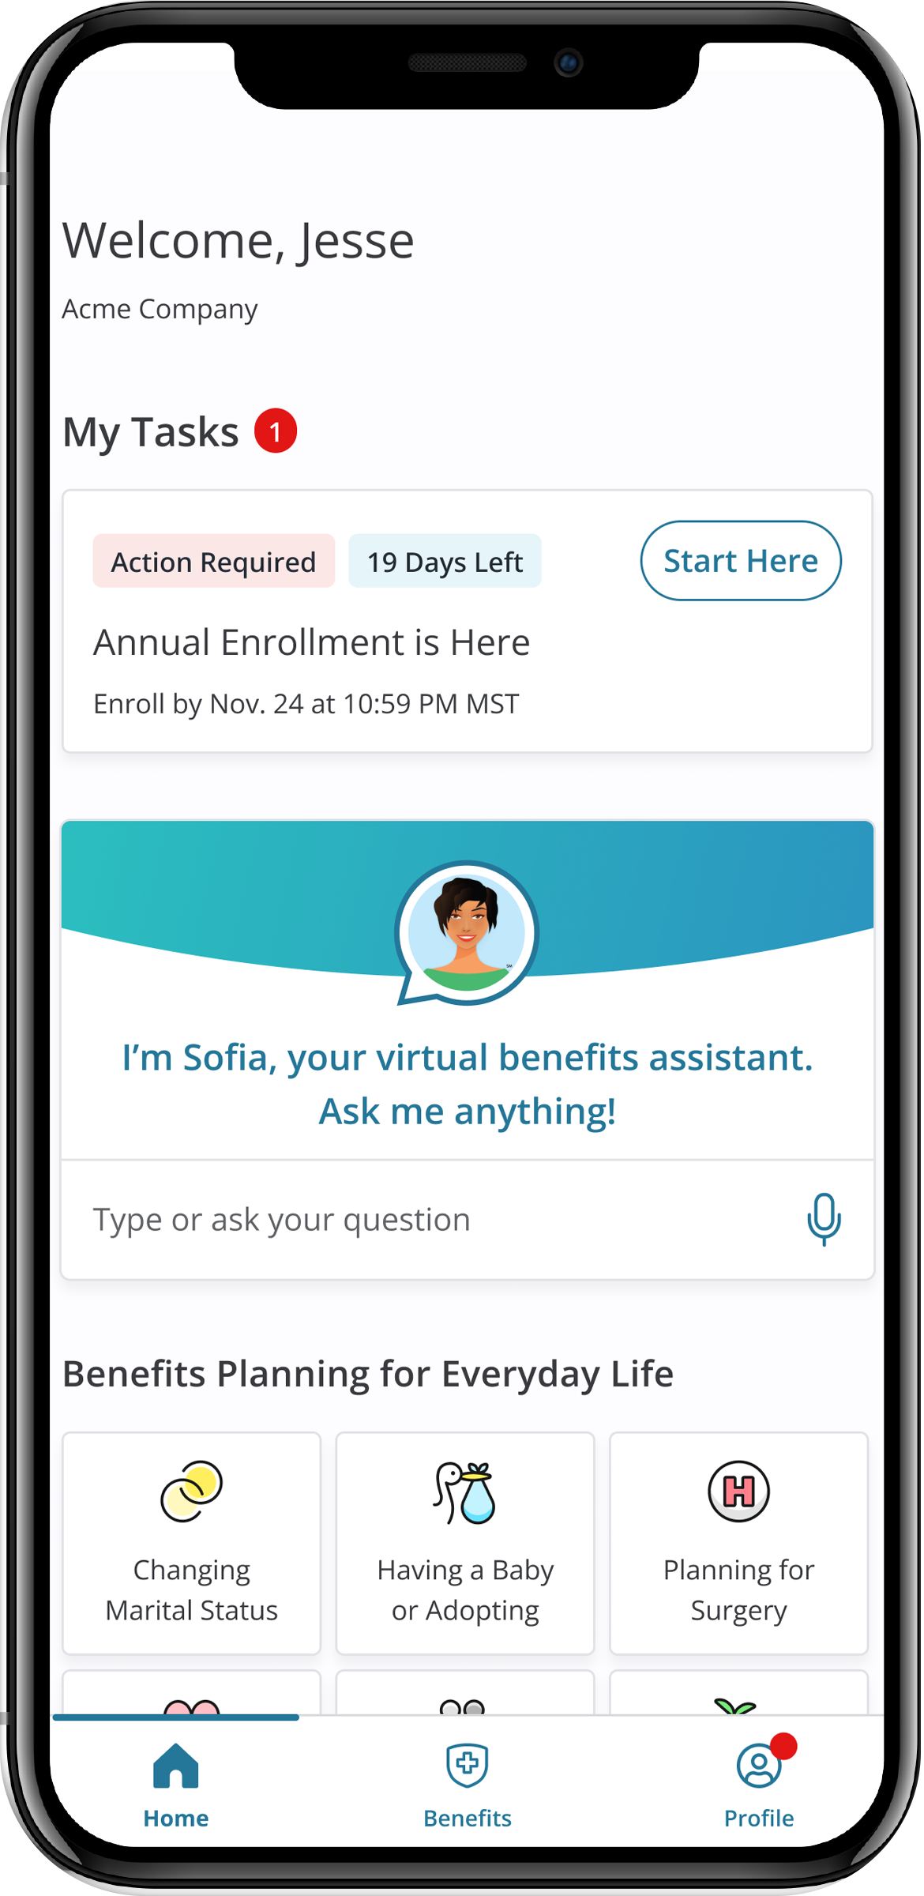

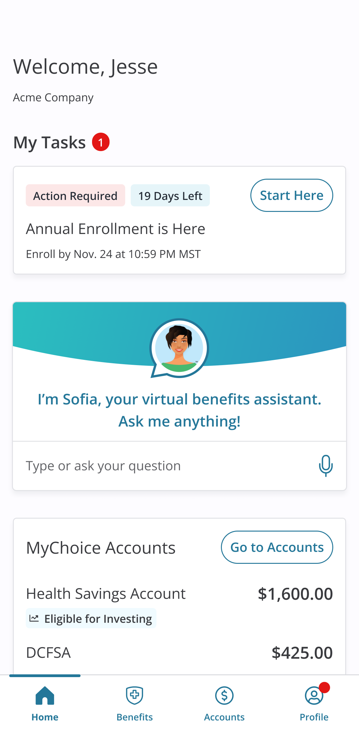

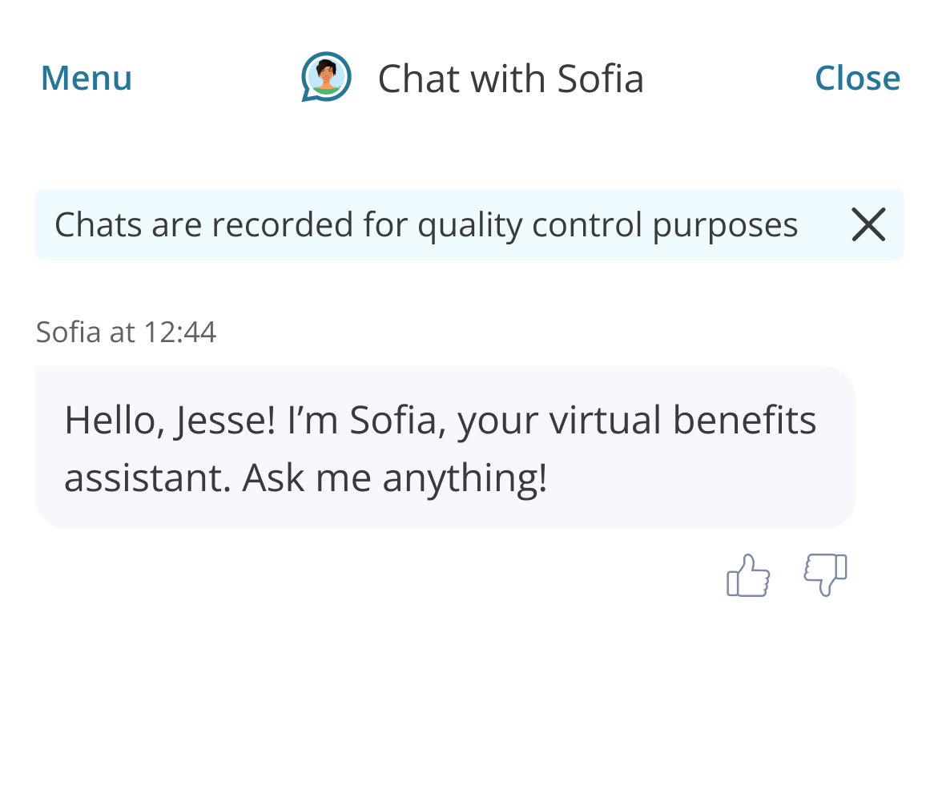
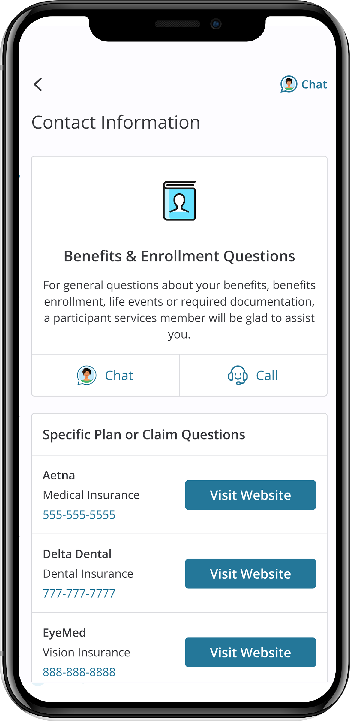
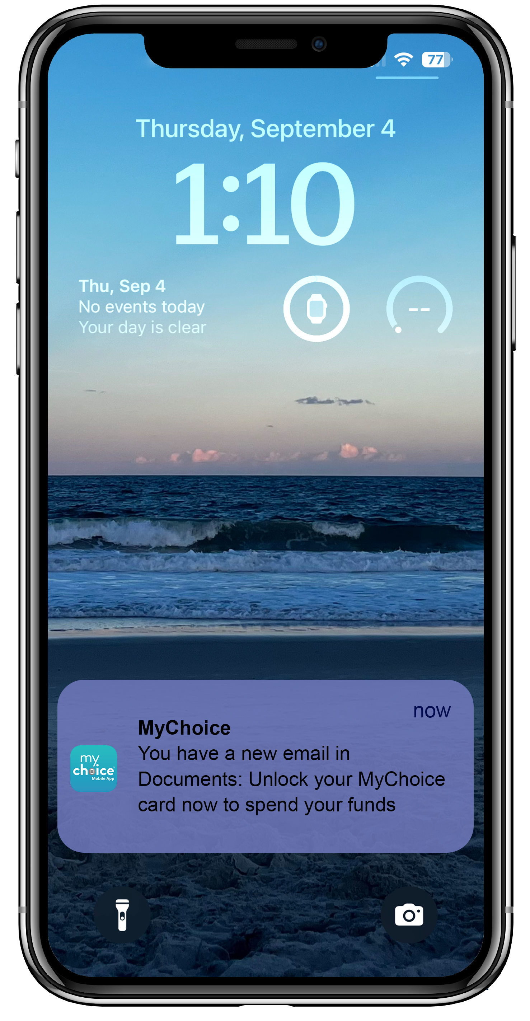
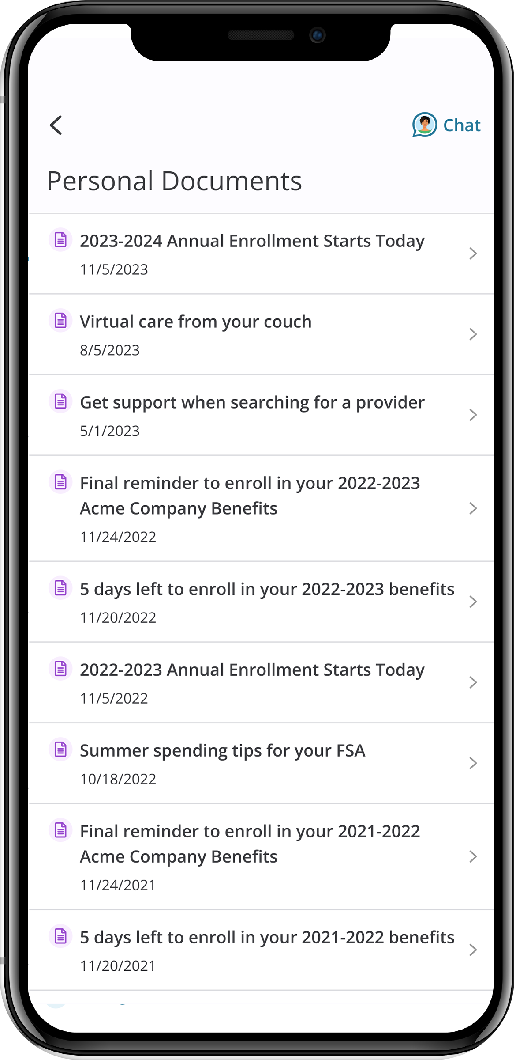
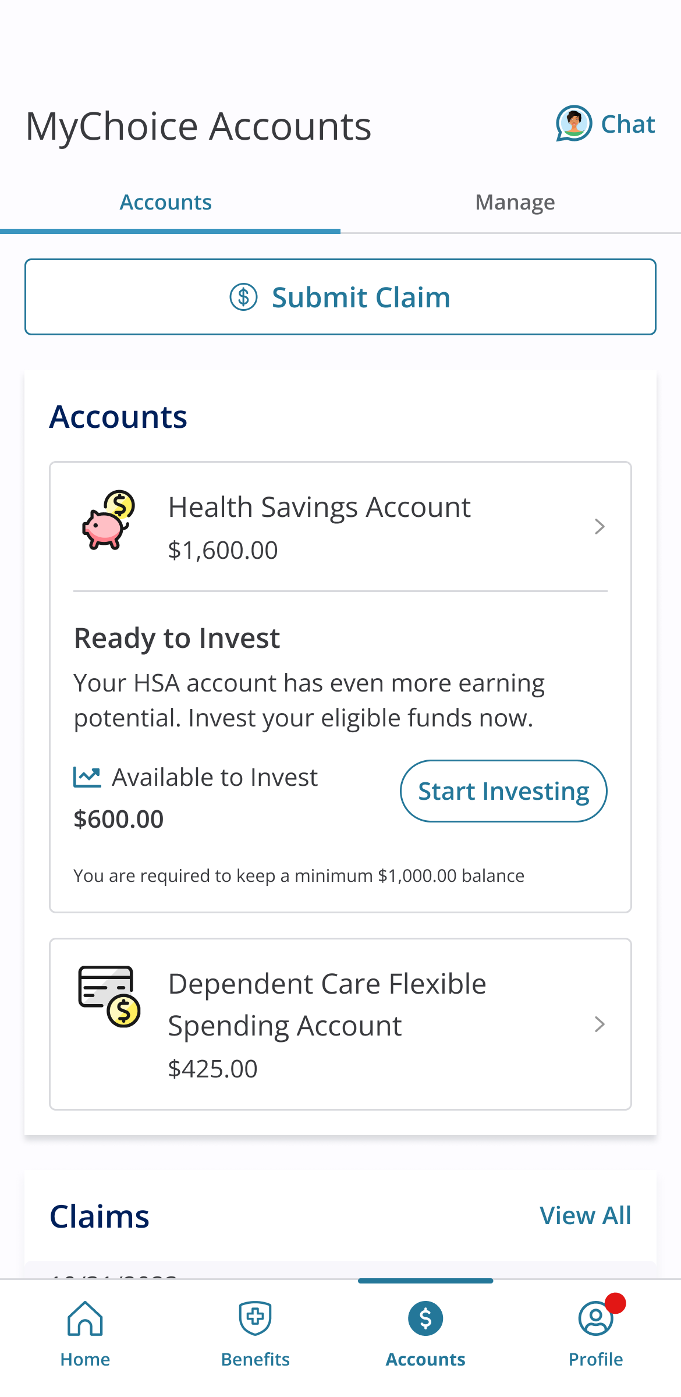
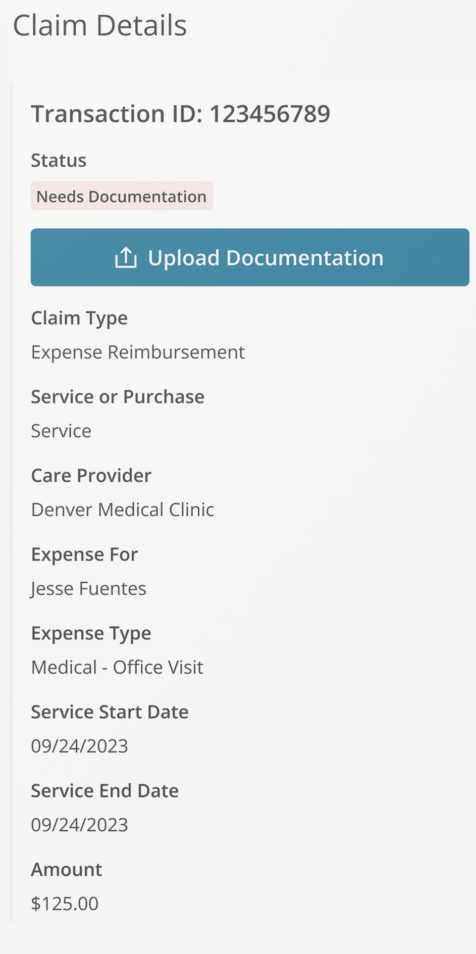
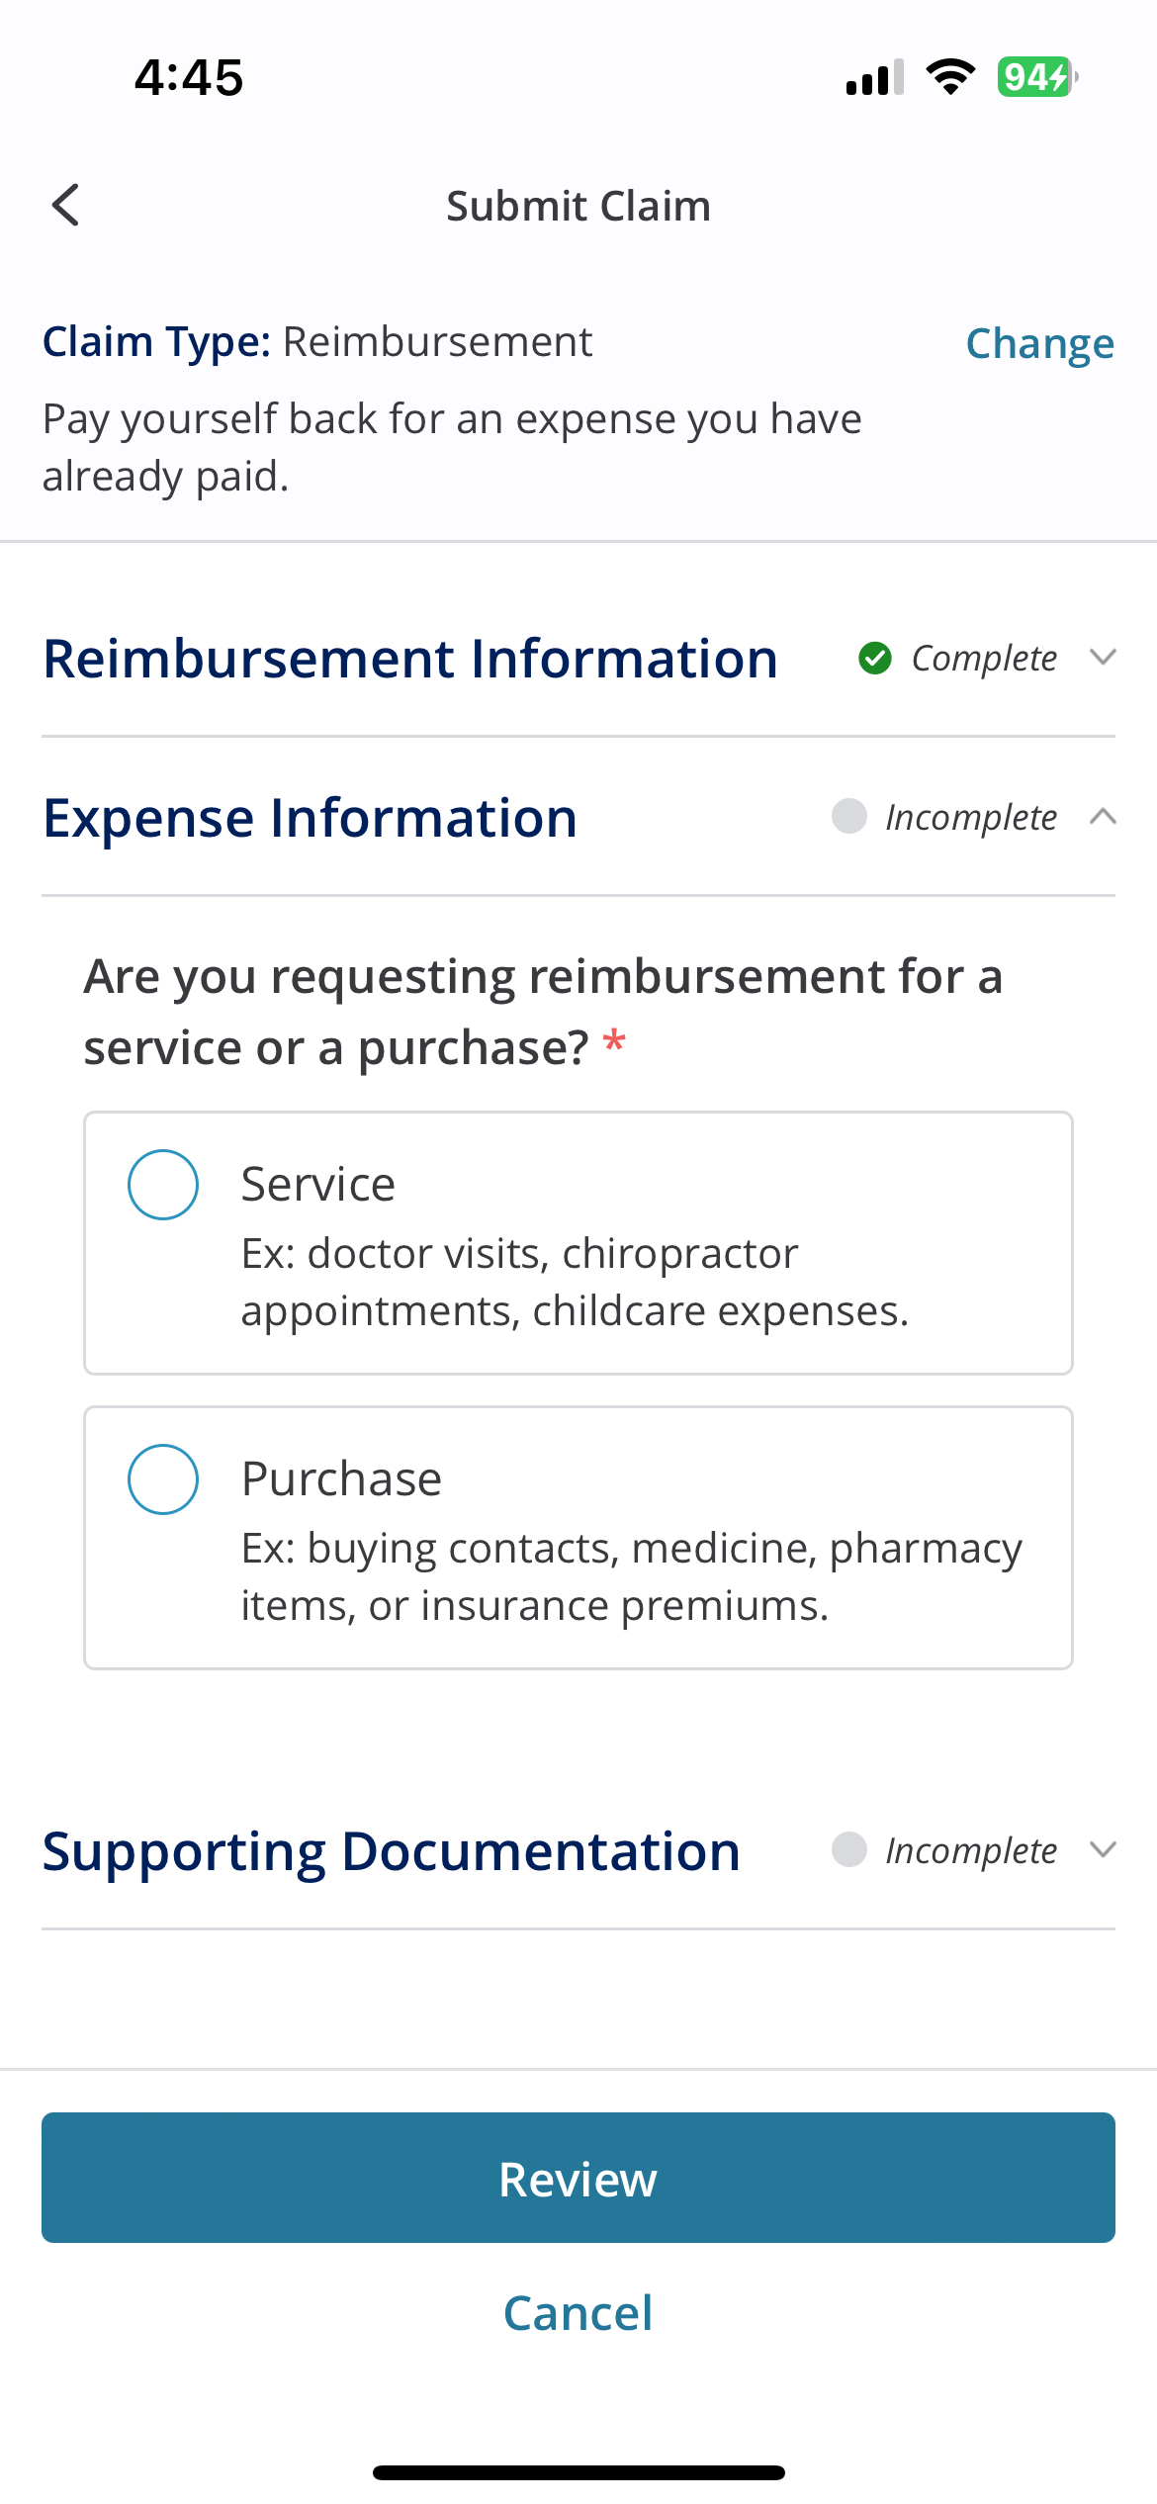
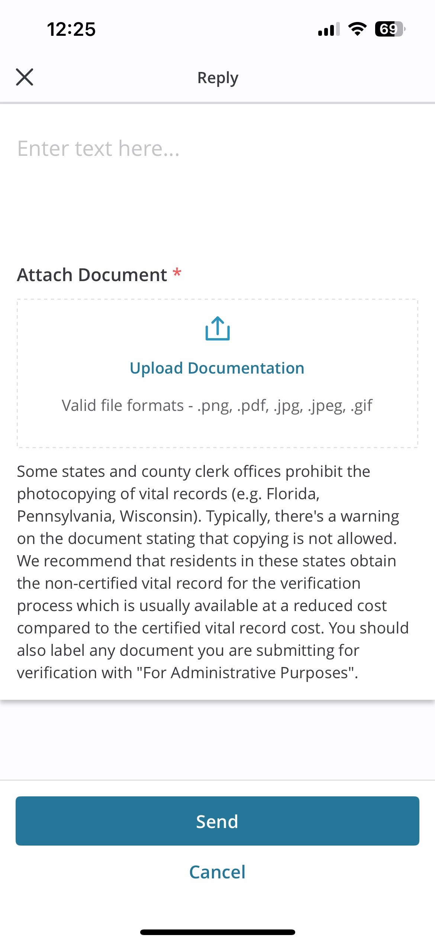
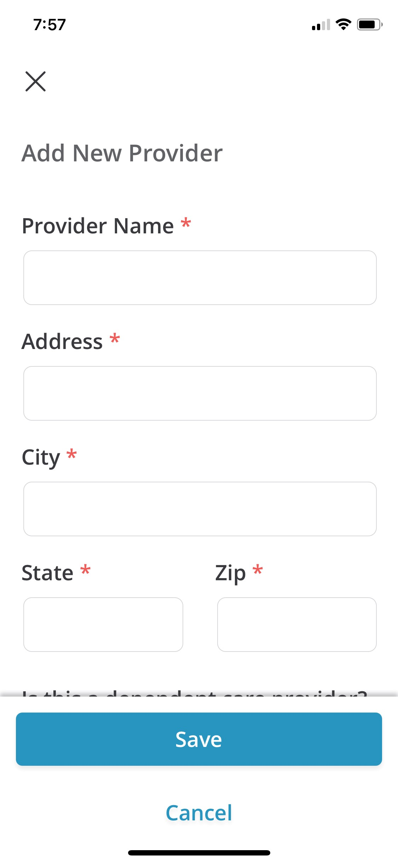
QUESTIONS? ASK SOFIASM
If you need help with your accounts, you can chat with Sofia, your 24/7 personal benefits assistant. Find Sofia online and in the MyChoice® benefits app.
If she can’t answer your questions, she will point you in the right direction for answers.
Sofia speaks over 52 languages, and can answer questions regarding 400,000 benefits topics, including:
MyChoice Accounts
Claims/reimbursement status
Account balance
Deadlines
Documentation
And more!
Claim needs documentation
USE THE MYCHOICE BENEFITS APP YEAR-ROUND TO:
Manage Accounts
View Claim Details
Submit Claims
Push Notifications
Upload Documents
Pay a Provider

